Slide 1
Virtual Machines: The Azure Cloud Platform
Dr. Leon Jololian

Slide 2
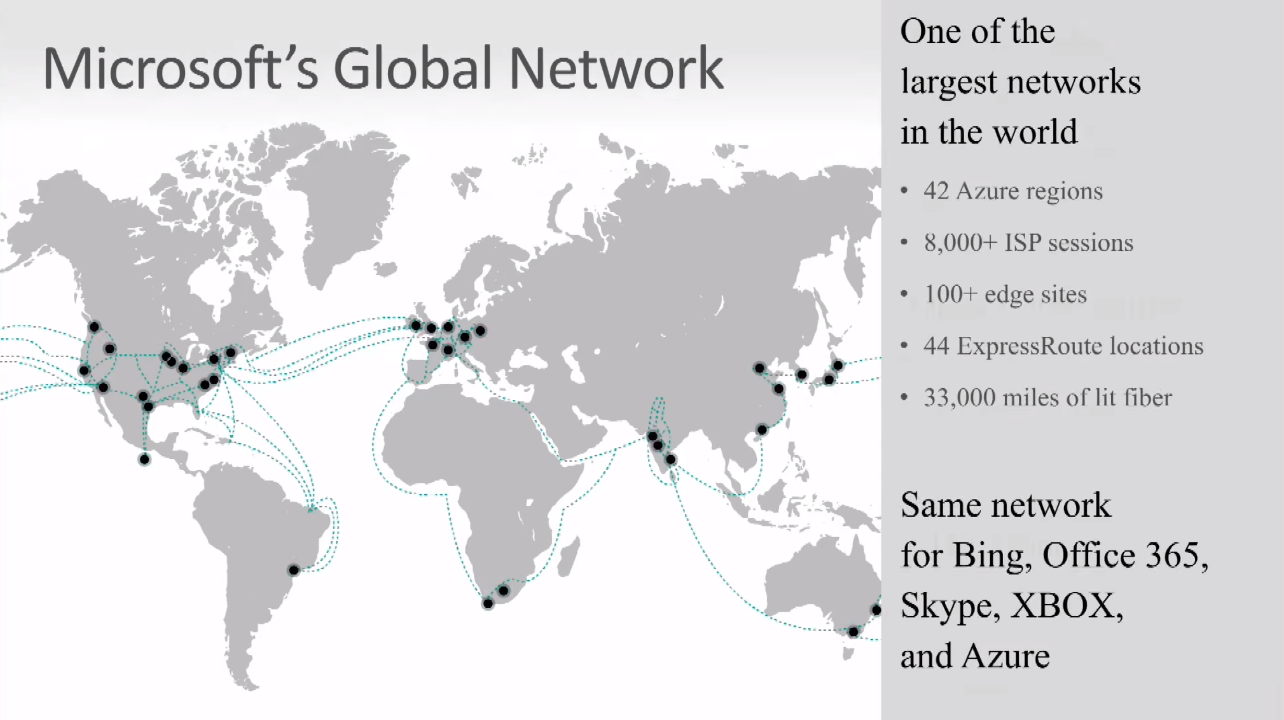

Slide 3
Review of Major Concepts
Physical
Server
Virtual
Server
IaaS
PaaS
SaaS
Physical Servers: WYSIWYG; Inherent Limitations.
Virtual Server: e.g. Hyper-V, VMware. Several VMs reside on a single
physical server. Virtual HD, memory, CPU. Stop, Save, and
clone a VM. High reliability.
IaaS: Users have to administer the operating system and the app
running, but need not be aware of the hardware.
PaaS: e.g. Web App running. User needs to install and configure
the software, but there is no need to know where
the software is running.
SaaS: e.g. Office 365, the software is available on demand.
No need to install, manage, upgrade, or secure the
software. No awareness of the operating system.

Slide 4
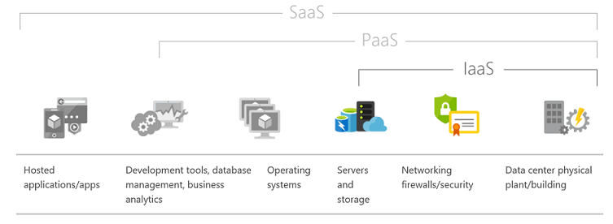

Slide 5
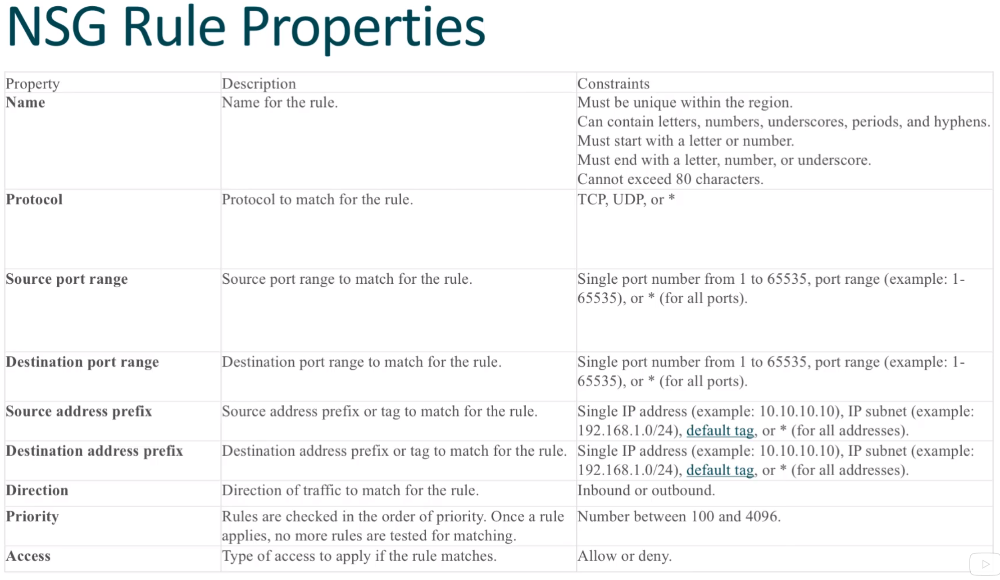

Slide 6
Uses of VMs
Dev/test: Virtual machines provide a quick and easy way to create different operating system and application configurations. Dev/test can then easily delete the VMs when they are no longer needed.
Running applications in the cloud: The ability to run certain applications in the public cloud as opposed to creating a traditional infrastructure to run those applications can provide substantial economic benefits. (Elasticity and Cost).
Extending your data center to the cloud: An organization can extend the capabilities of its own on-premises network by creating a virtual network (VNET) in the cloud and adding VMs to that VNET.
Disaster recovery: We can use an IaaS-based approach to disaster recovery, and obtain significant costs savings. If a primary datacenter fails, you can create the VMs running on the cloud to run critical applications, then shut them down when the primary datacenter is once more operational.

Slide 7
Examples of when to use IaaS-based VMs
Highly available service workloads such as commercial online stores.
Unpredictable growth workloads like those experienced by small, but rapidly expanding organizations, or short-term increased sales of fad items.
Spiking workloads, such as those experienced by sites providing news services.
Steady workload scenarios where organizations simply want to offload their infrastructure to the cloud.
Periodic workloads such as retail sales spurts during holidays.

Slide 8
Workloads not Suitable for IaaS
Low volume or limited growth workloads where the organization might be able to run the service or application on commodity hardware on-premise less expensively than in the cloud.
Regulated environment workloads where an organization, or even the local government, may regulate the type of data that can be hosted in the cloud. Alternative may be a hybrid solution.

Slide 9
VM Series
A Series: Entry level for Dev/Test
D Series: General purpose
F Series: Optimized for compute (Web apps)
G Series: Optimized for memory and storage (SQL, ERP, SAP)
H Series: High performance (Modeling, AI)
L Series: Storage optimized (Data warehousing, Cassandra, MongoDB)
N Series: GPU enabled

Slide 10
Accessing the VM
VMs have firewall rules that govern access.
Common ways of accessing VMs:
Secure Shell (SSH) for Linux
Remote Desk Top (RDP) for windows
Access to applications:
HTTP/HTTPS
FTP
Other services

Slide 11
Connecting Local Infrastructure to Cloud
Site to site Virtual Private Network (VPN): connects local network to the Azure network.
Users can access the VMs as if they on the same LAN: manage, configure, share data, browse file servers, and run scripts on the VMs as local machines.
Azure vNet: Multiple Azure networks in multiple regions.
Active Directory and Domain Controller: Multiple file server VMs can have their own DC on the cloud.
ExpressRoute: for very fast connections.

Slide 12
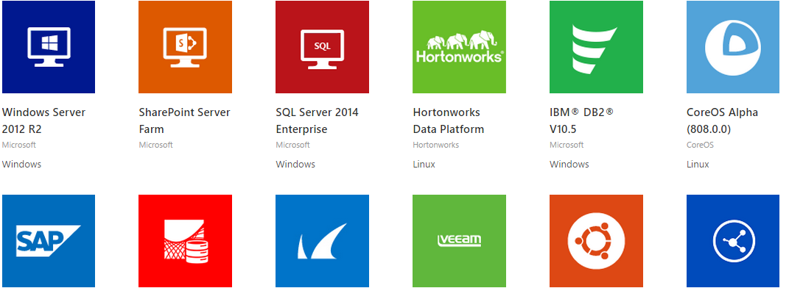
VM Images

Slide 13
Visual Studio
An integrated development environment (IDE) from Microsoft.
Used to build apps for Android, iOS, and Windows devices.
Supports different programming languages. Built-in languages include C/C++, VB.NET, C#, Python, Ruby, and Java among others.
Also supports XML, JavaScript, and CSS.

Slide 14
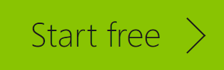
Creating a New Azure Account
Go to: https://www.azure.com
Click on the button

Slide 15
Virtual Machines (VM)
Azure Web Sites
https://portal.azure.com
Provisioning a VM from Images
Provisioning VM from Gallery
Managing VMs: Dashboard, Monitor, Endpoints, Configure
Accessing VM with RDP
Attach Virtual Disks

Slide 16
Ways to Deploy Windows Virtual Machines
Azure Portal
Azure PowerShell
Azure CLI
Visual Studio
ARM

Slide 17
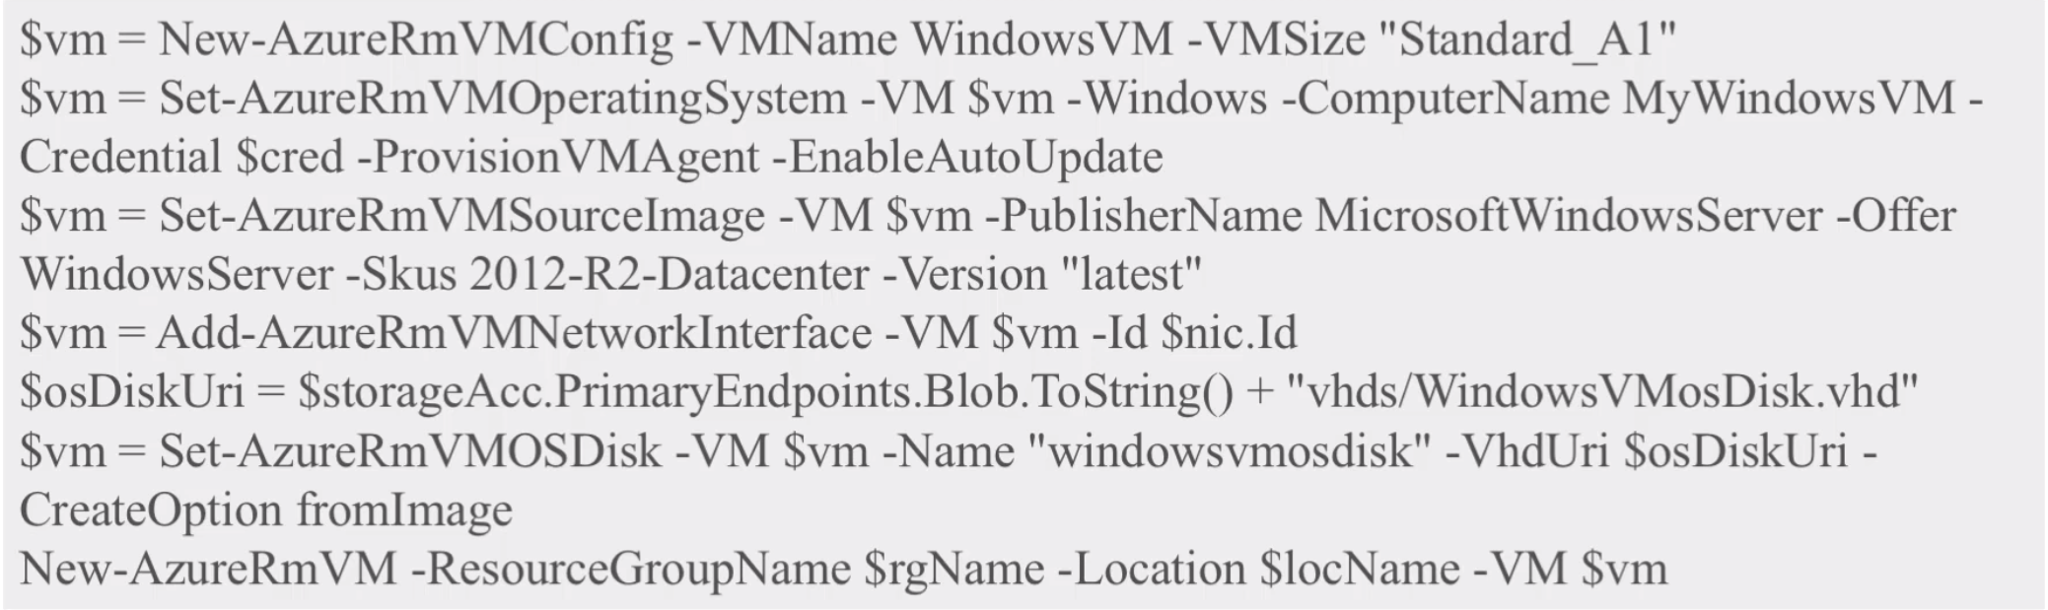
Using PowerShell to Provision a VM
Using CLI to Provision a VM
Similar to PowerShell.
Script oriented
Suitable for Unix users

Slide 18
Azure resource Manager (ARM)
If you Google: “Azure Quickstart Templates”, you can find sample templates.
An ARM is a text file that is written in JSON, JavaScript Object Notation, describing all the different characteristics of a VM.
Everything within Azure uses this language.

Slide 19
VM Parameters
Some of the parameters to consider when creating a VM:
Market place or Custom Image
License: your own or buy one
Storage: SDD or HDD; managed or unmanaged
Processing power: number of CPUs
Availability set: reliability
Network configuration
Extensions: e.g. anti-virus
Auto shutdown: save money
Monitoring / OS diagnostics

Slide 20
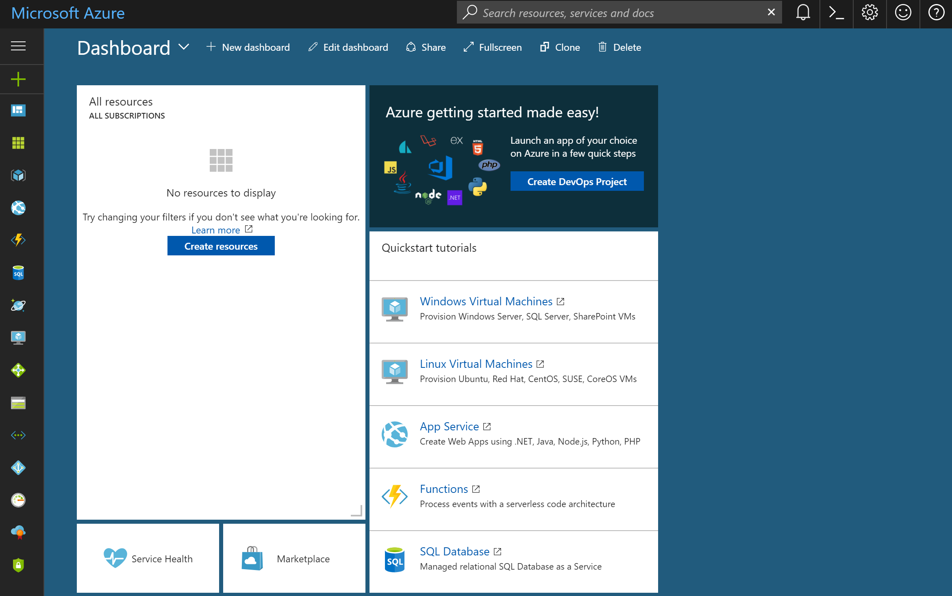
Dashboard Screen

Slide 21
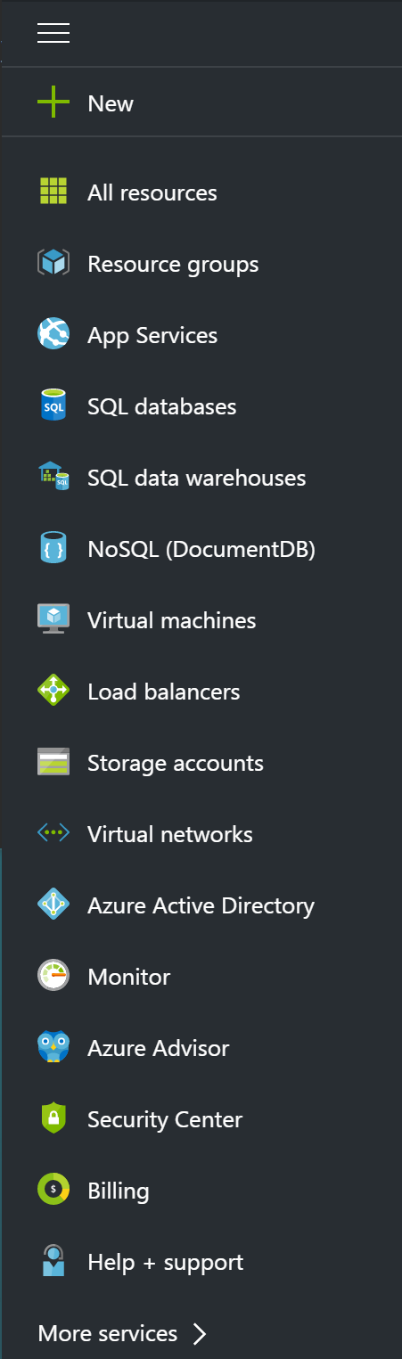
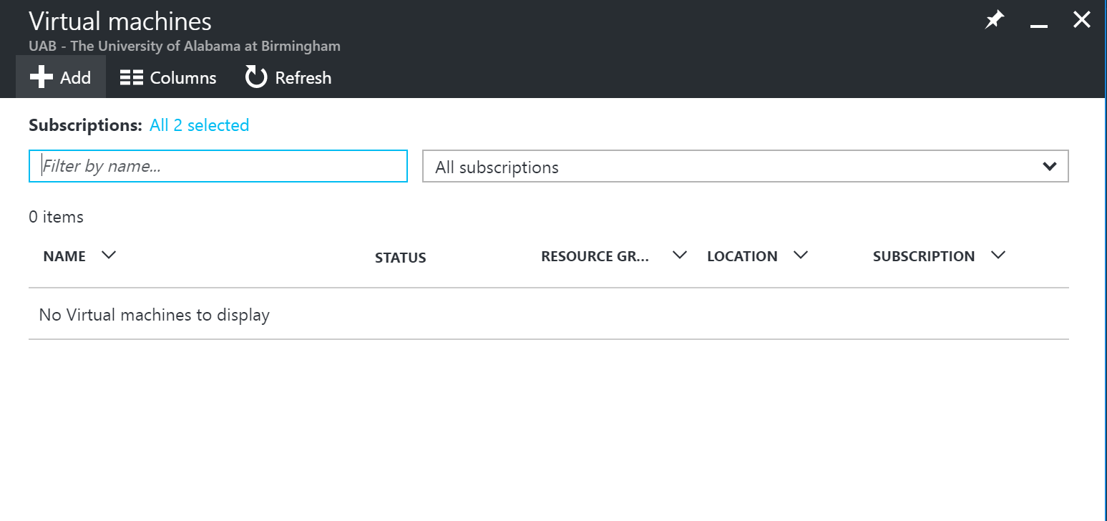

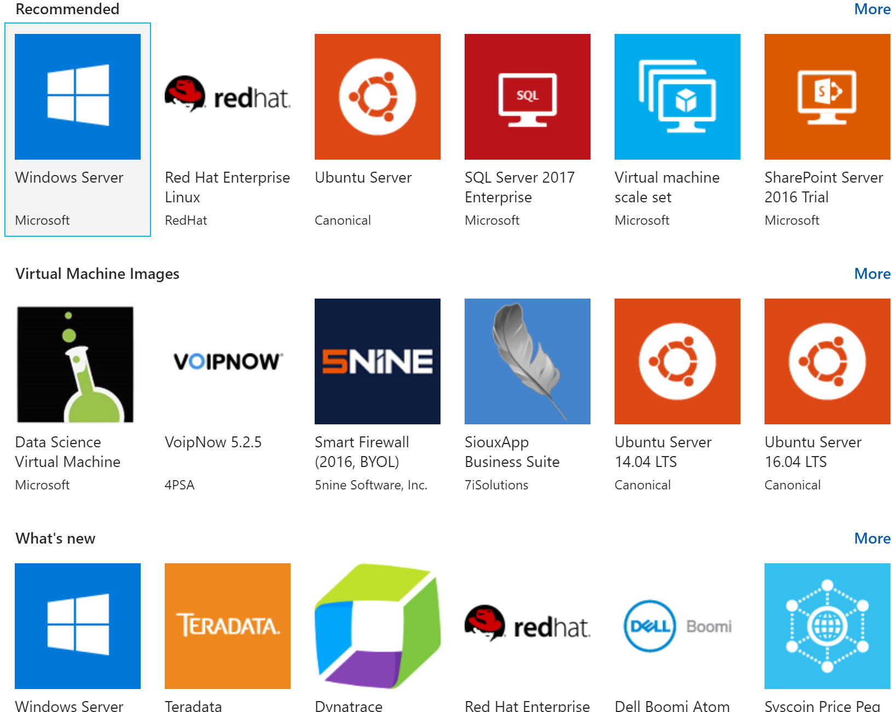
1
3
2
4
Provisioning VM
from Images

Slide 22
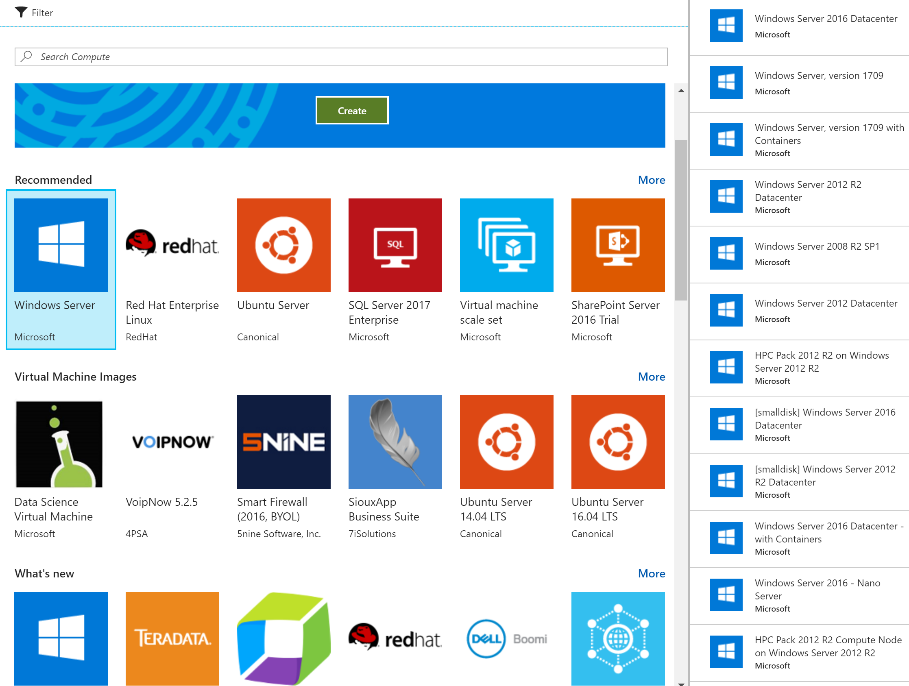
5

Slide 23
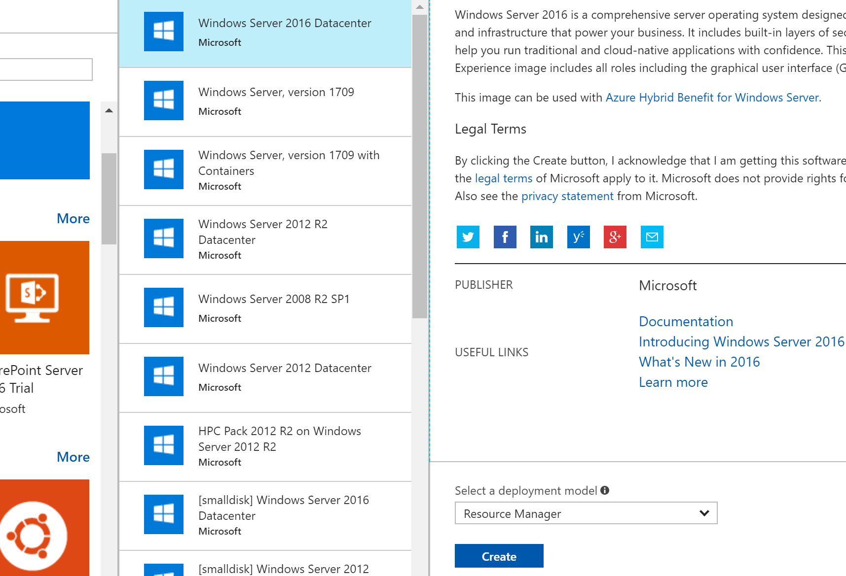

6

Slide 24
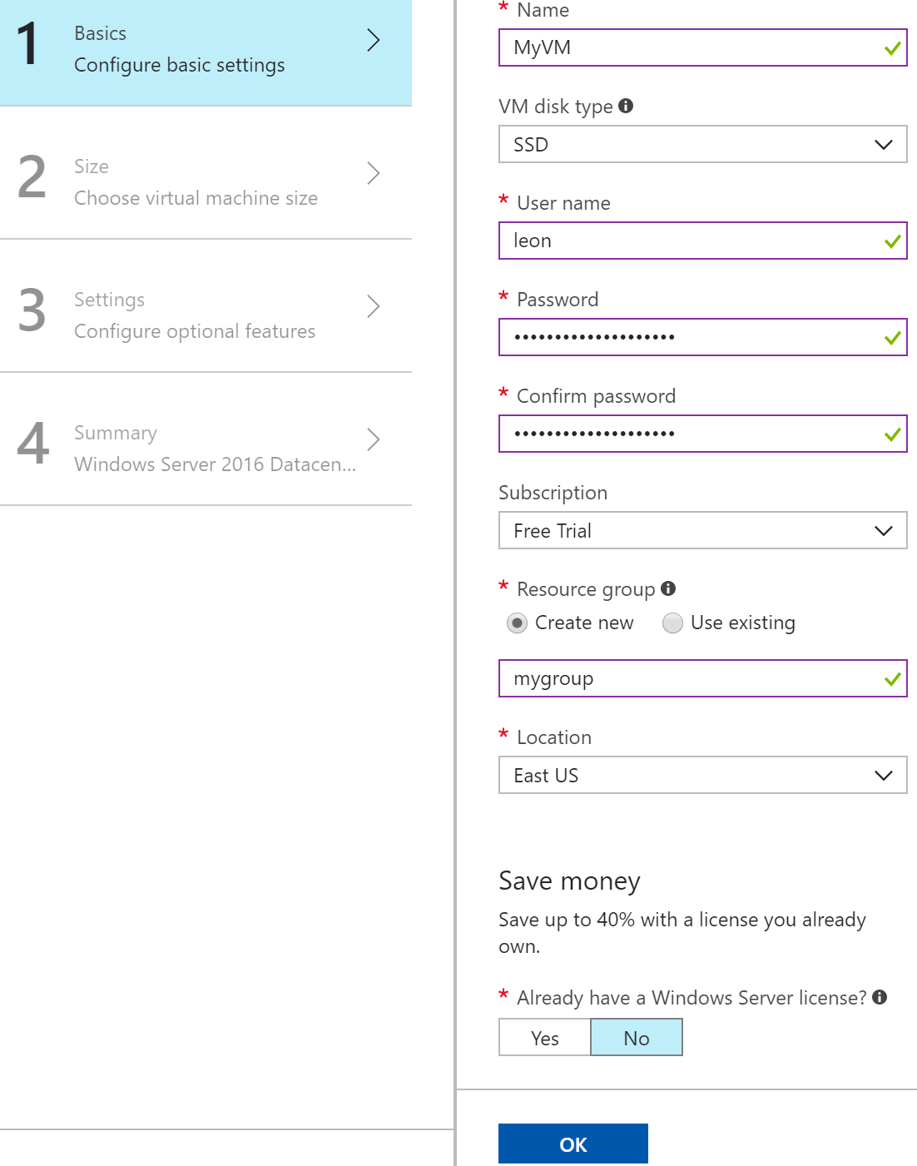
Configuring
7

Slide 25
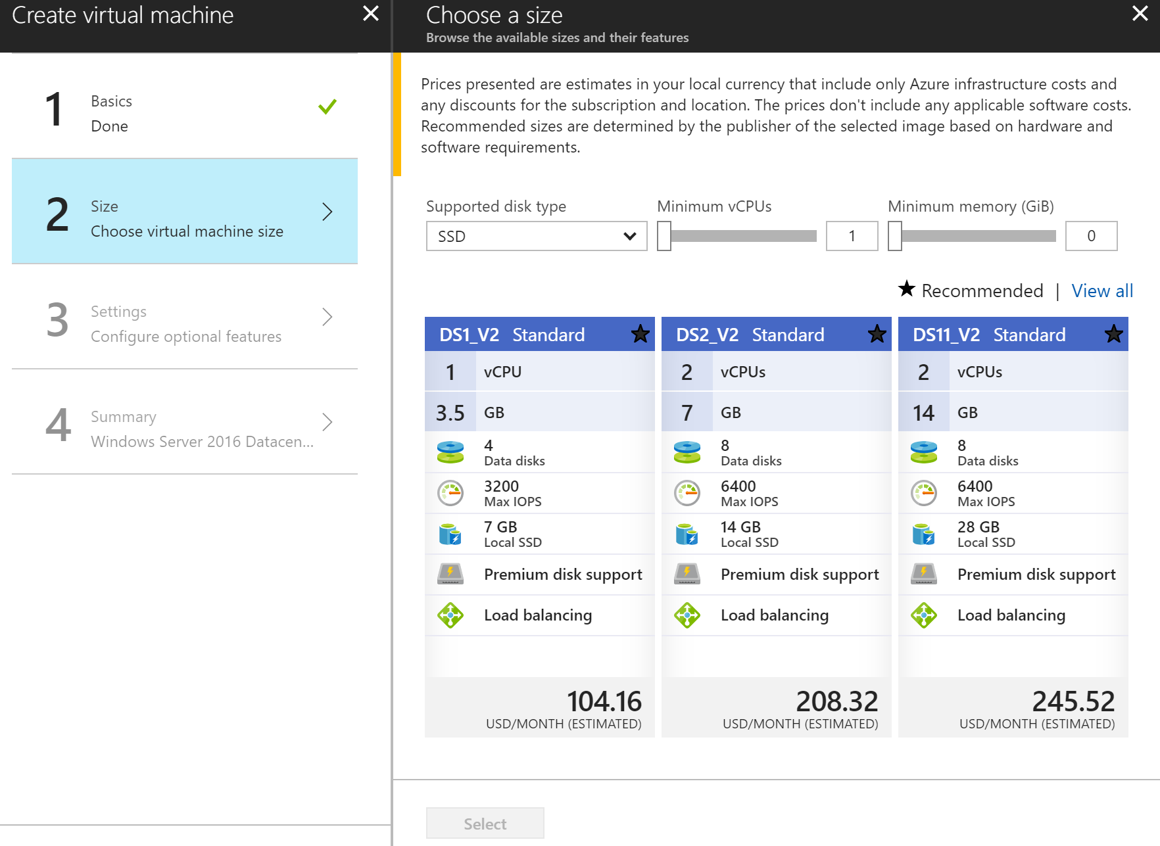
8

Slide 26
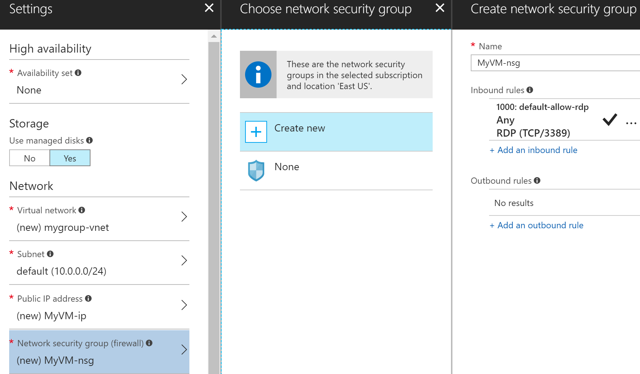
VM Settings
9

Slide 27
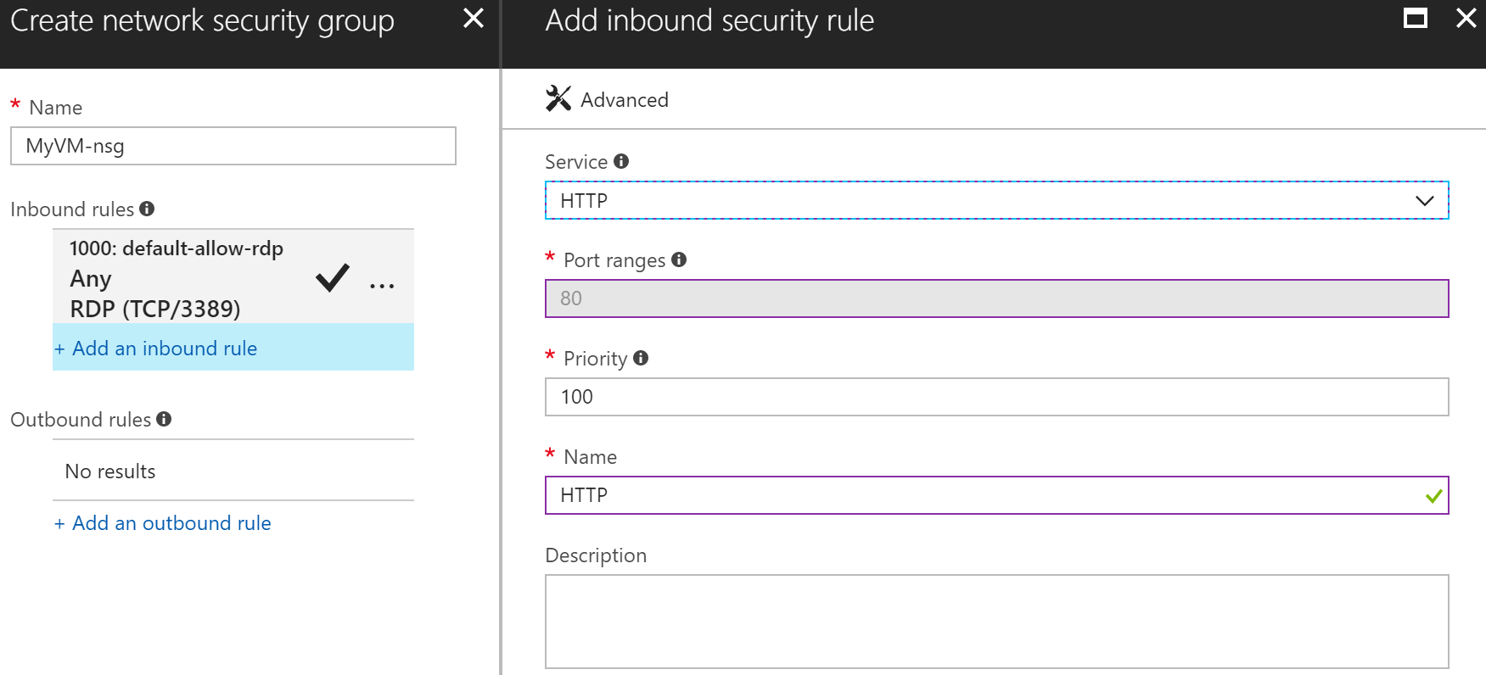
Enabling Incoming HTTP Requests

Slide 28
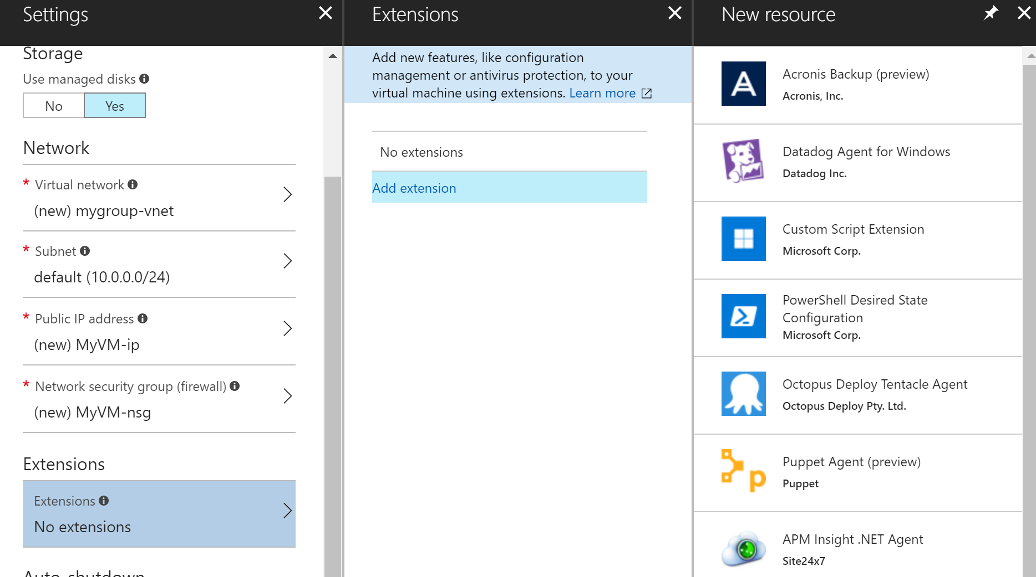
Adding Extensions

Slide 29
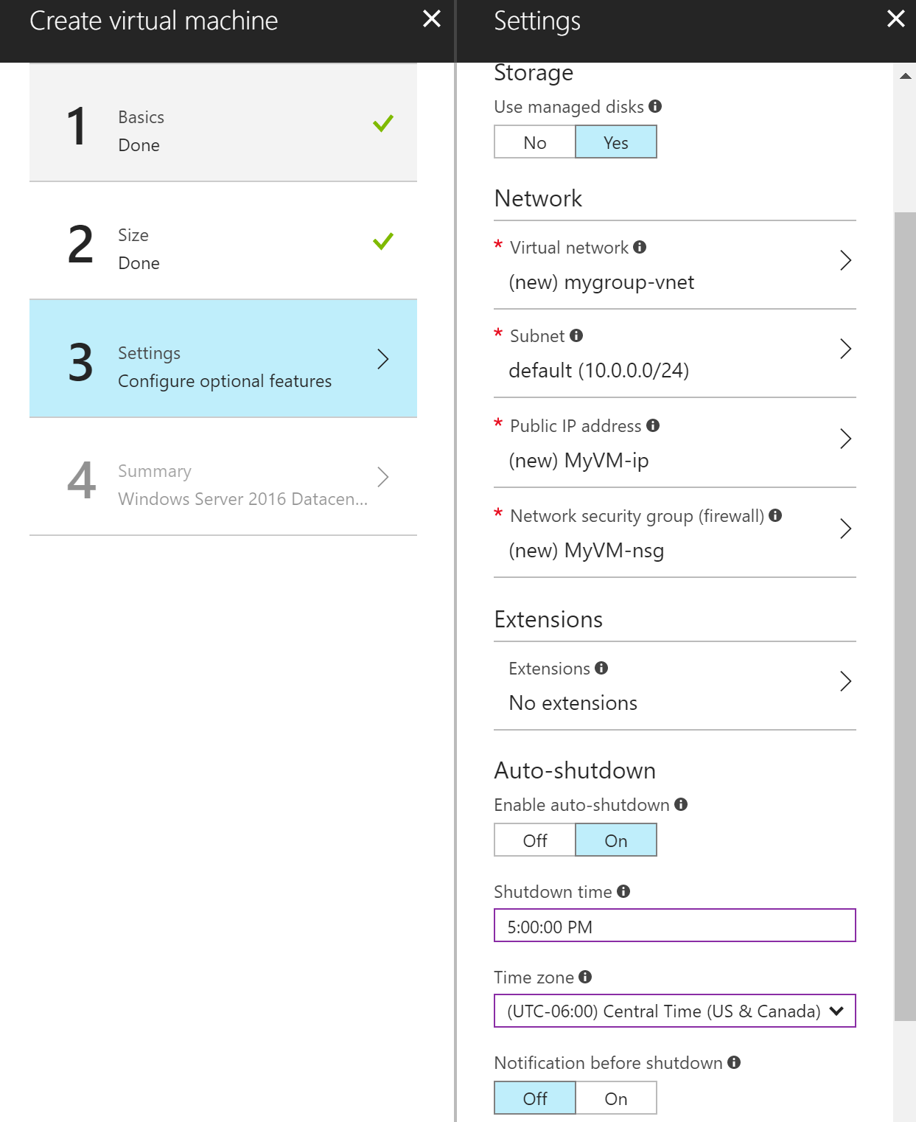
Auto Shutdown

Slide 30
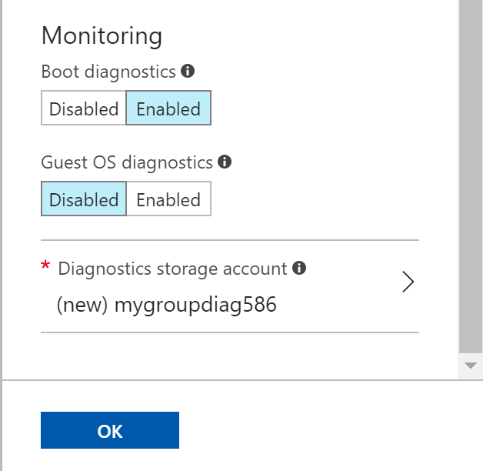
Monitoring / Diagnostics

Slide 31
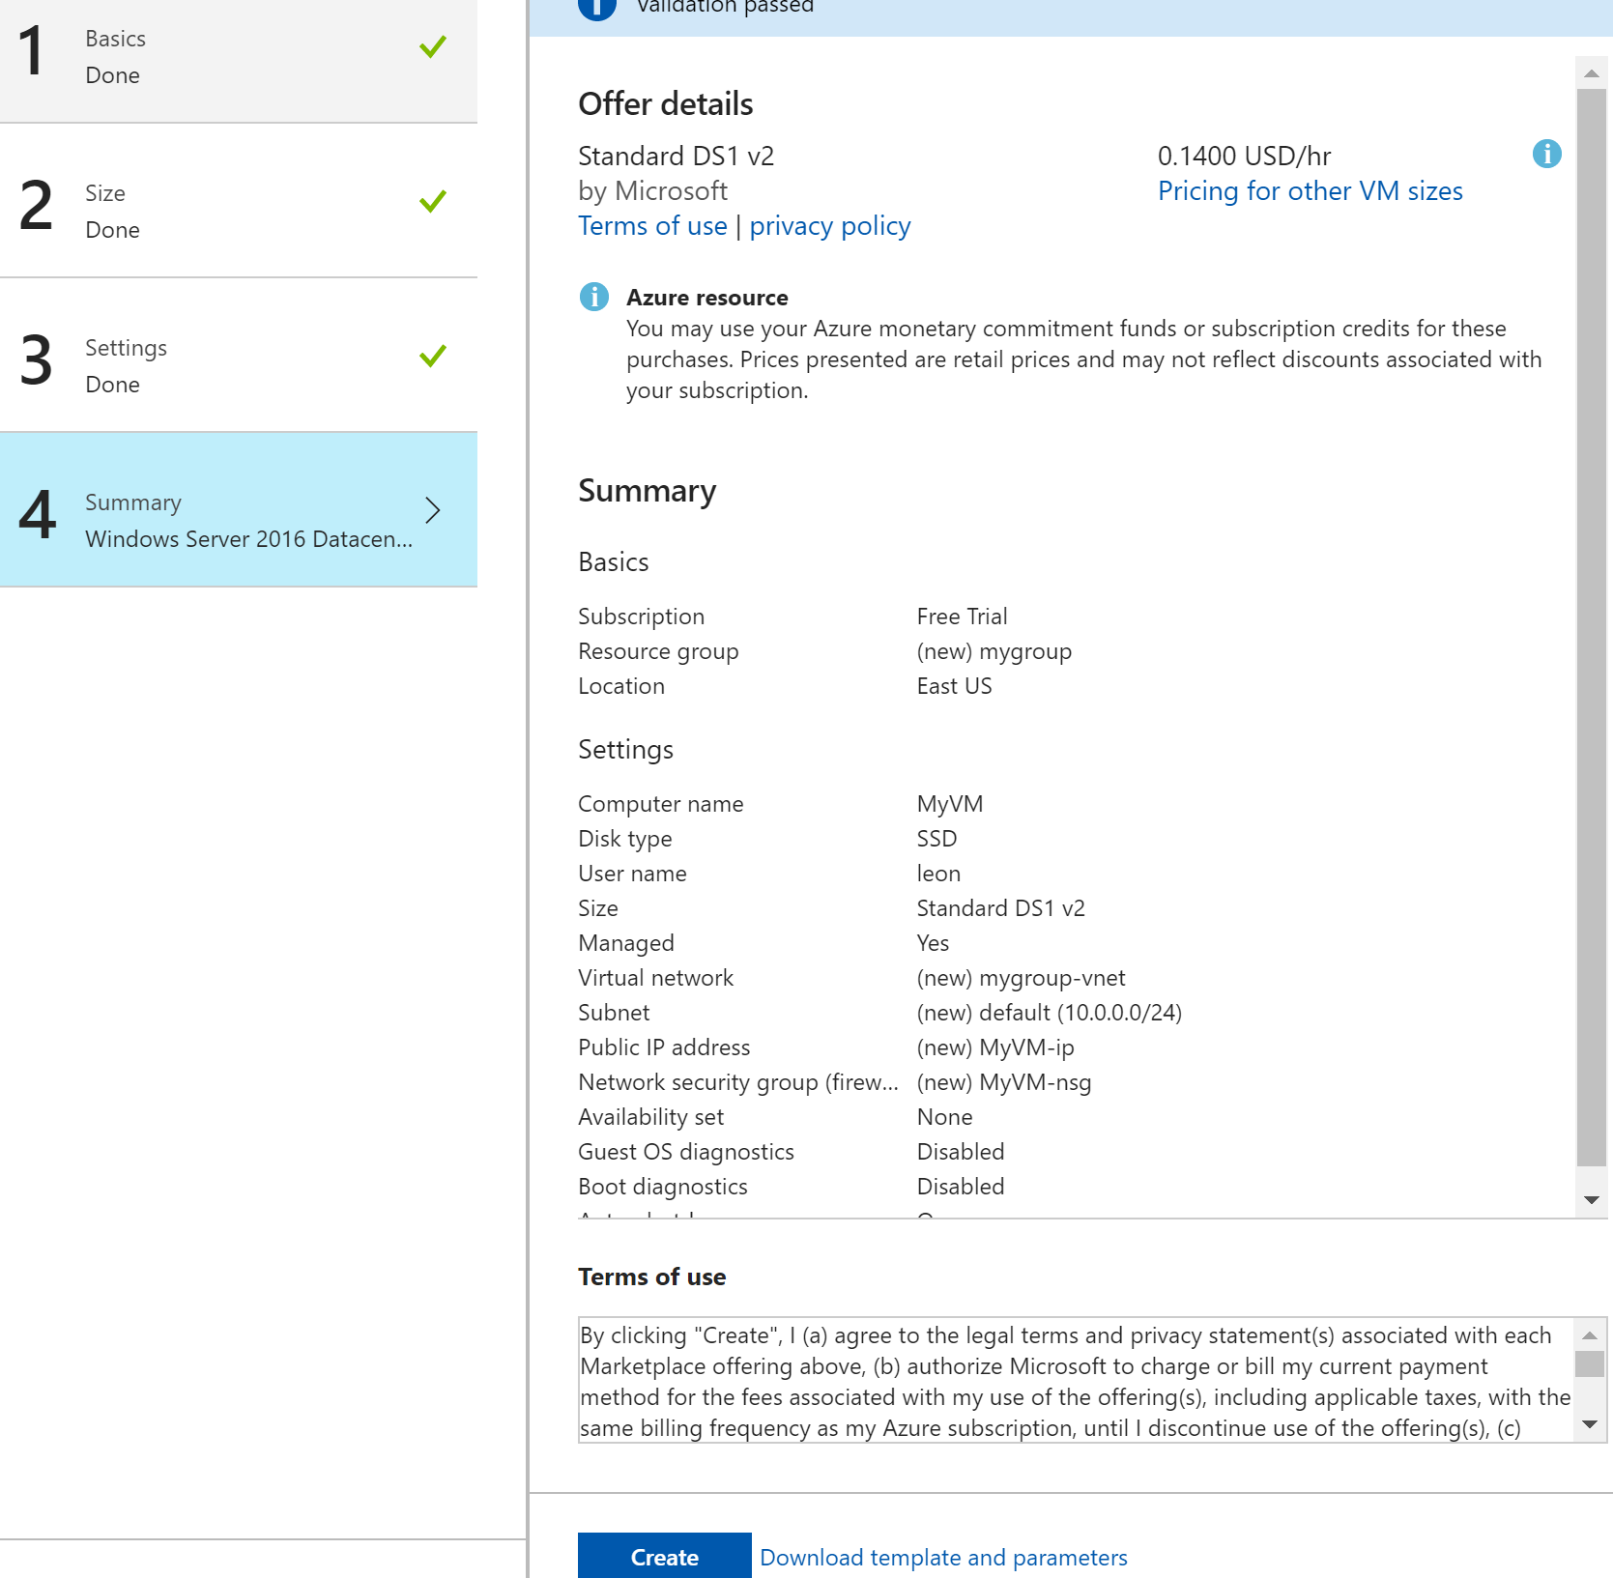
Summary

Slide 32
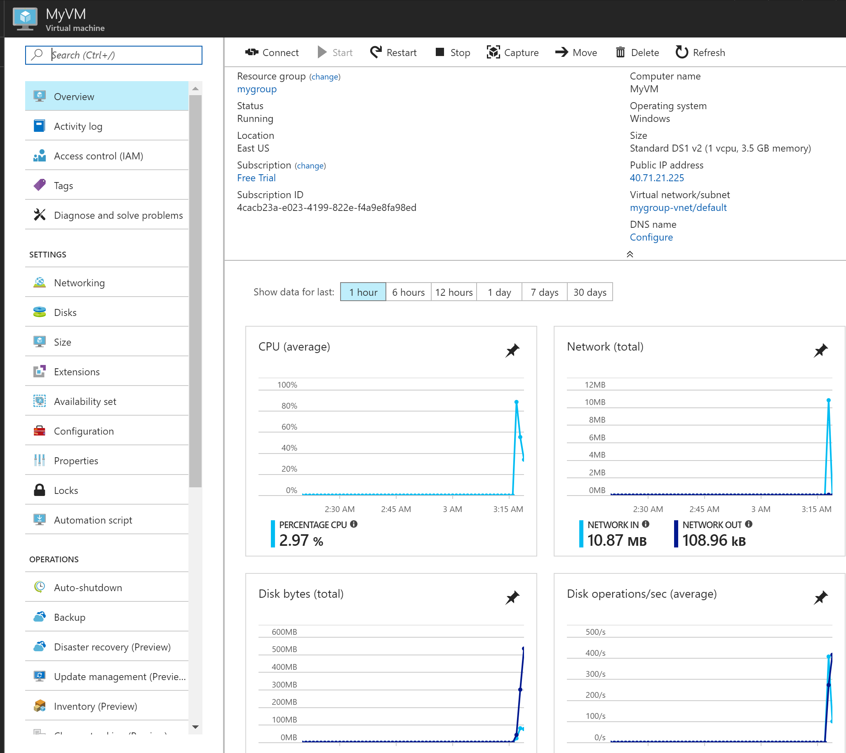

Slide 33
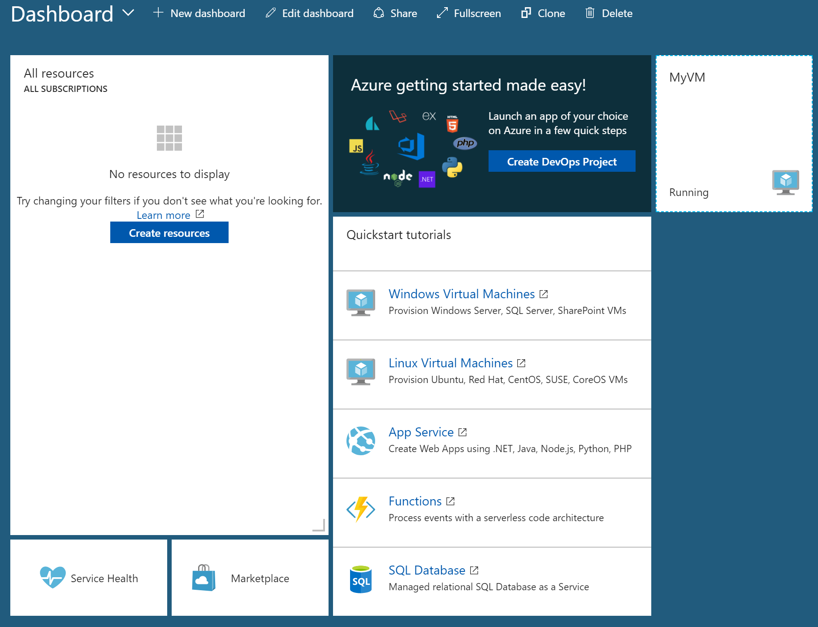

Slide 34
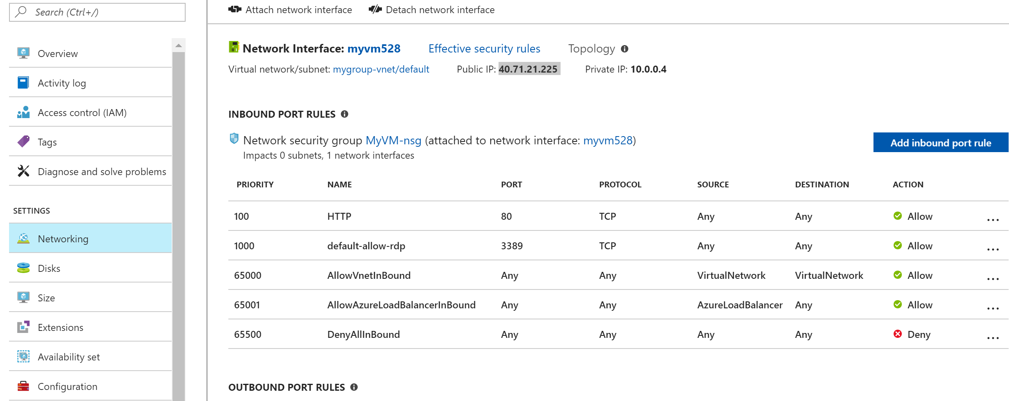
Public IP

Slide 35
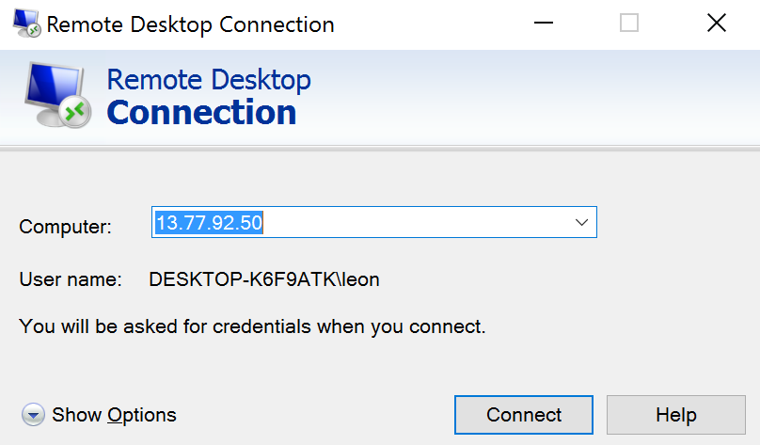
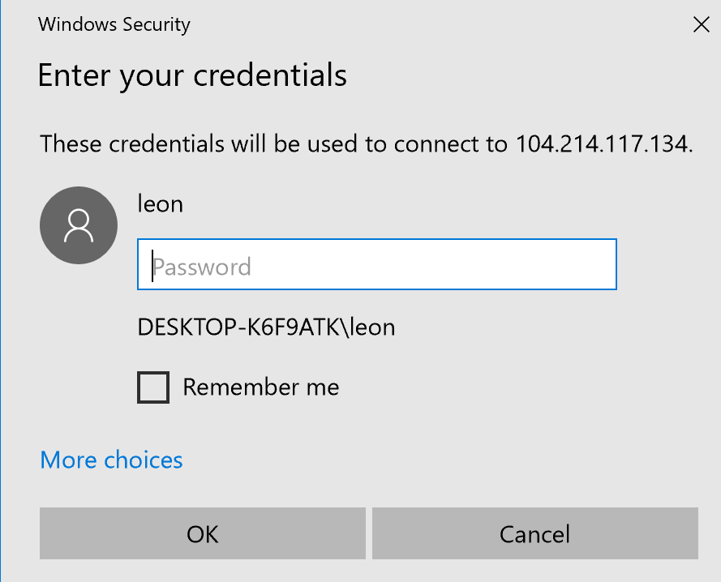
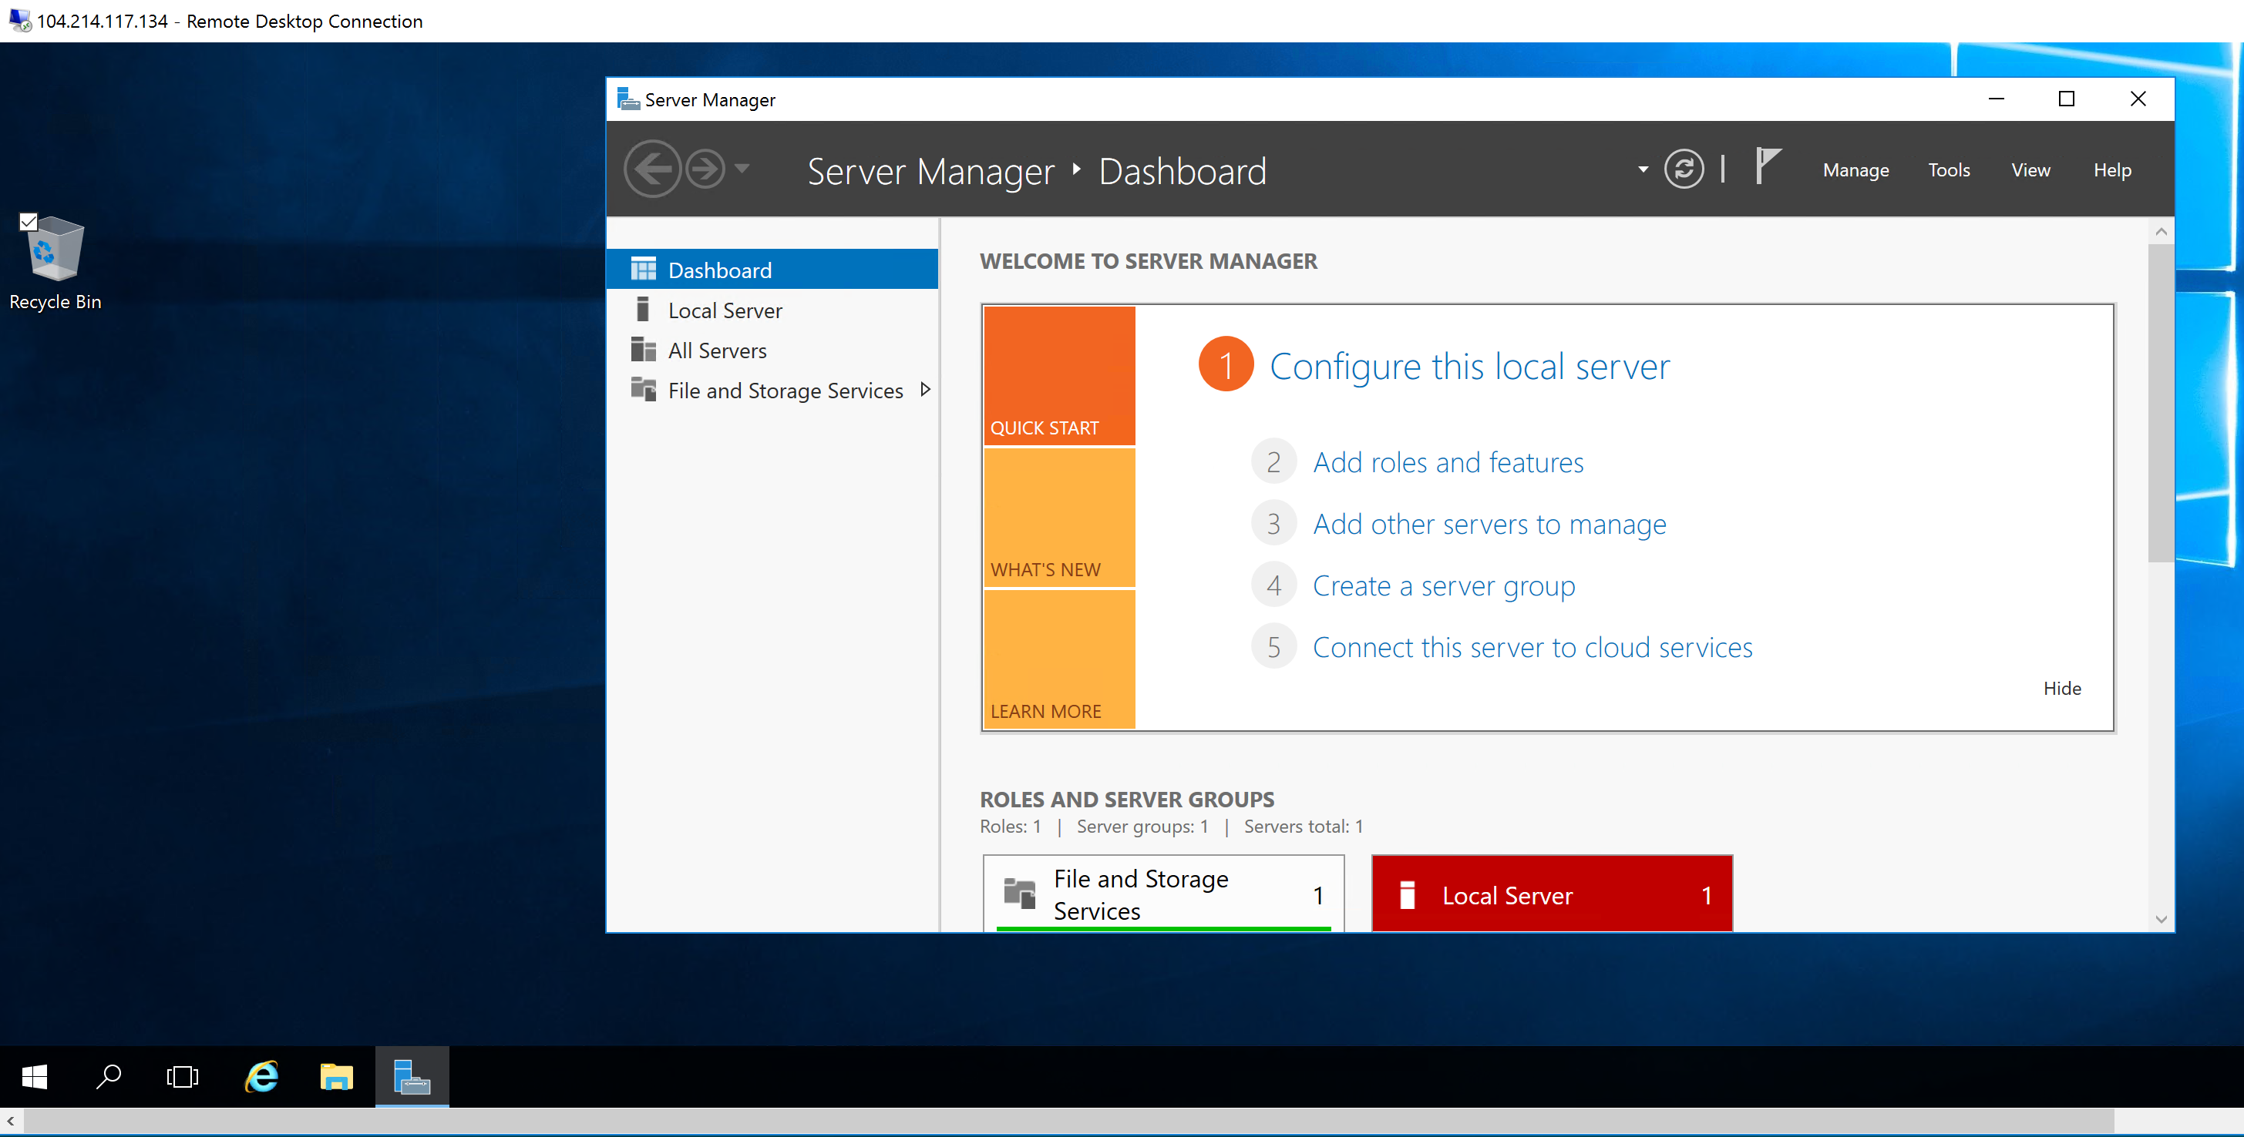
Connect to VM using RDP

Slide 36
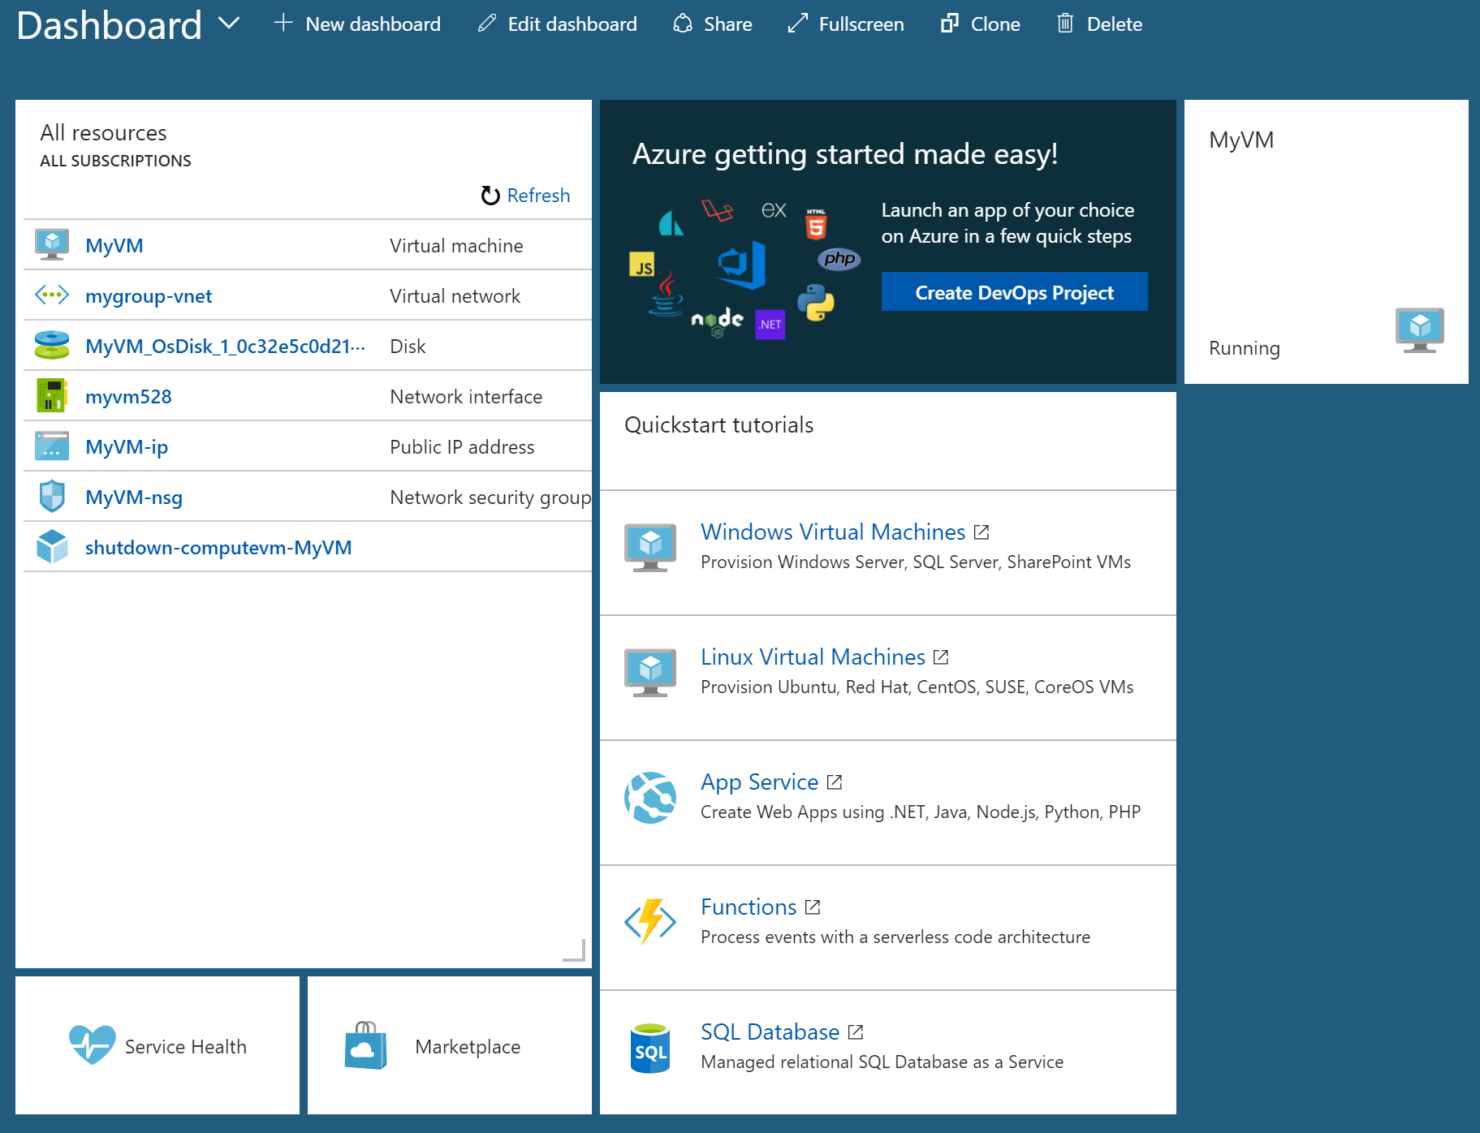
The Dashboard

Slide 37
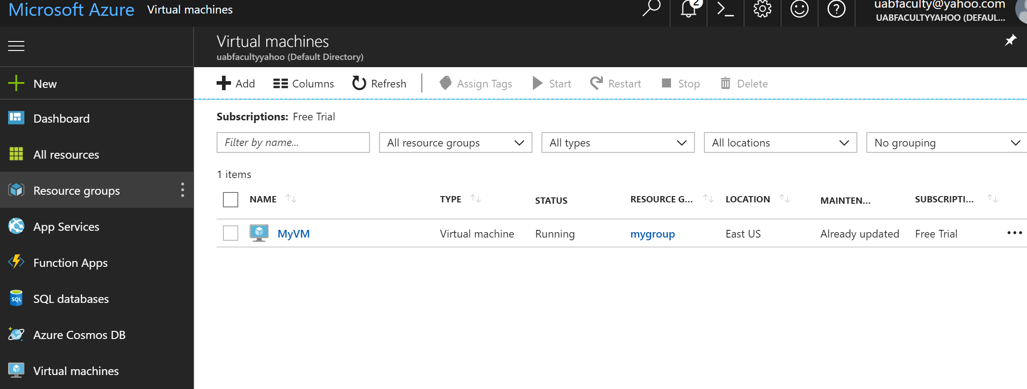
List of Virtual Machines

Slide 38
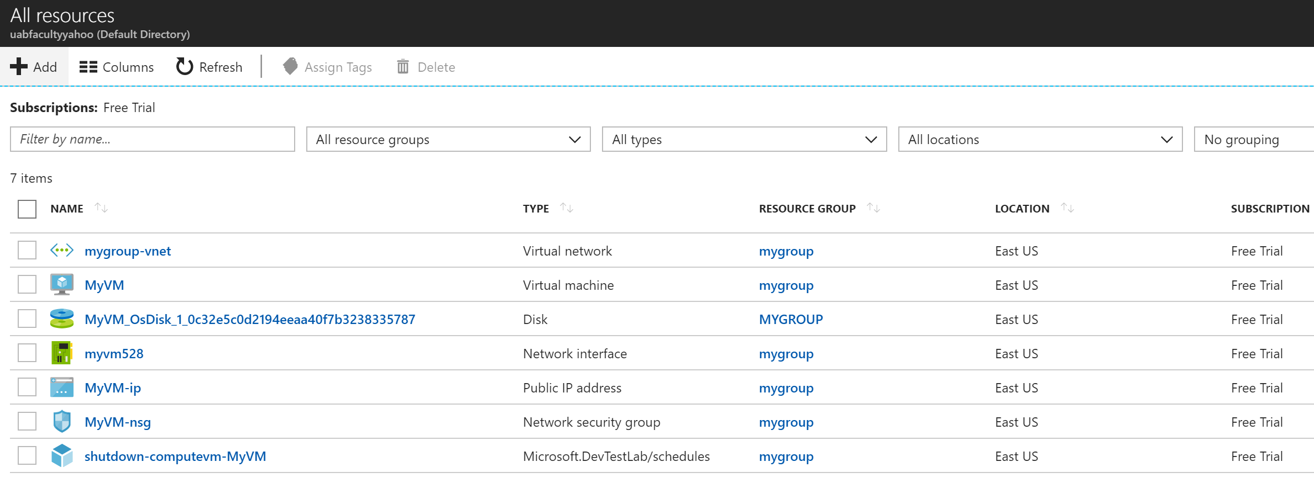
List of “All Resources”
To view security rules click on the Network Security group link (MyVM-nsg)

Slide 39
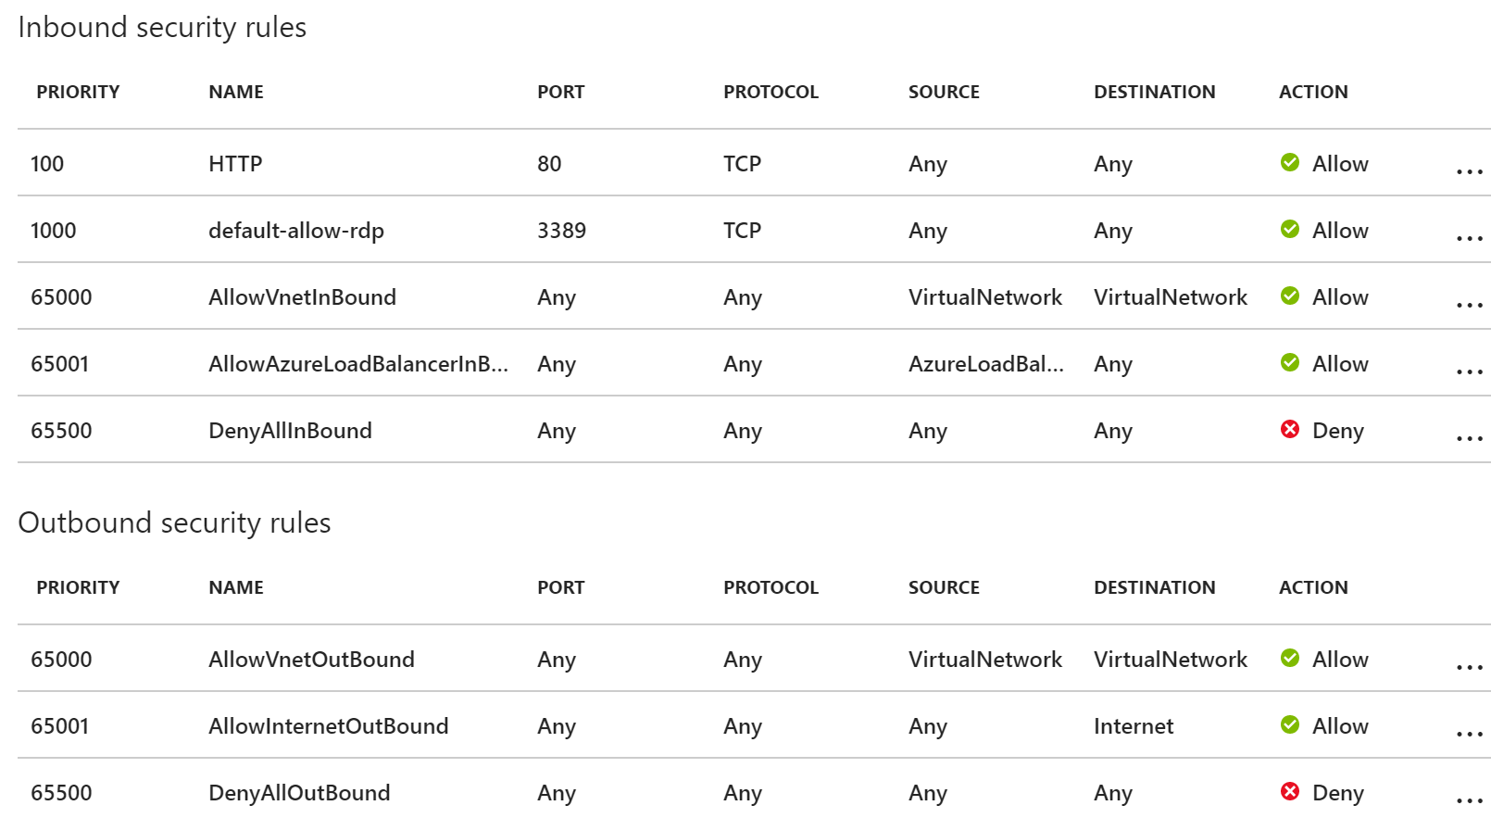
Network Security Group: Inbound and Outbound Rules

Slide 40
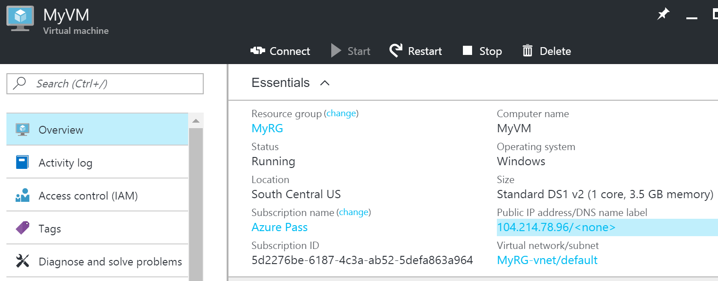
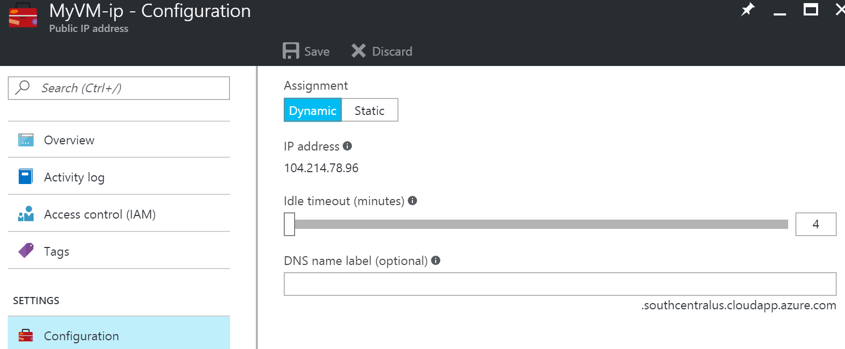
Click to assign
host and domain
name
Optional host name

Slide 41
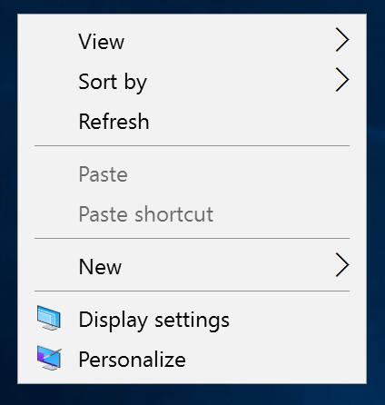
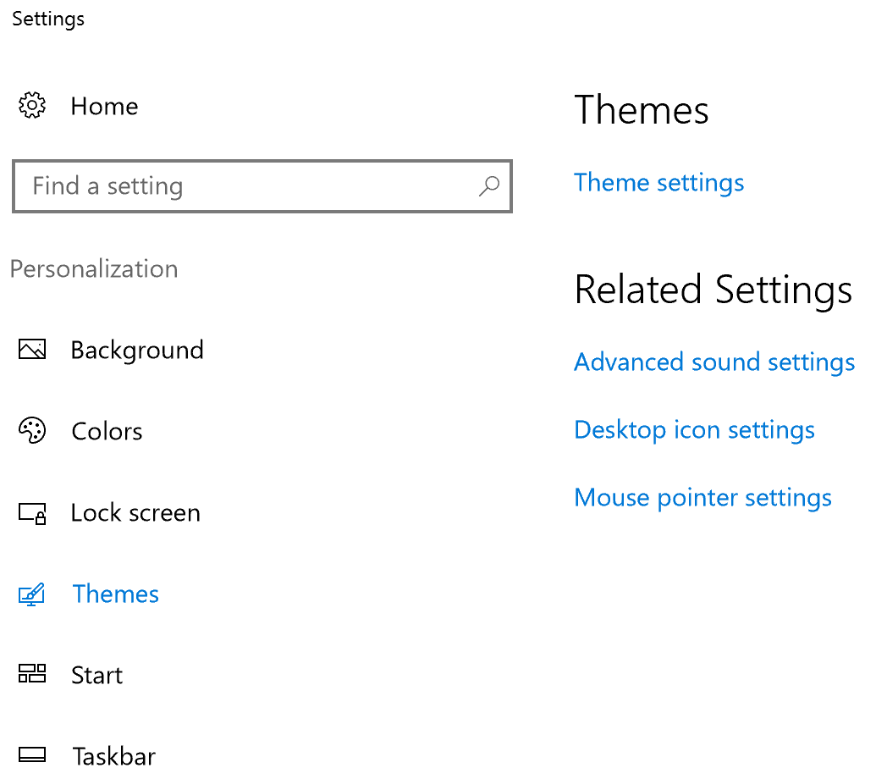
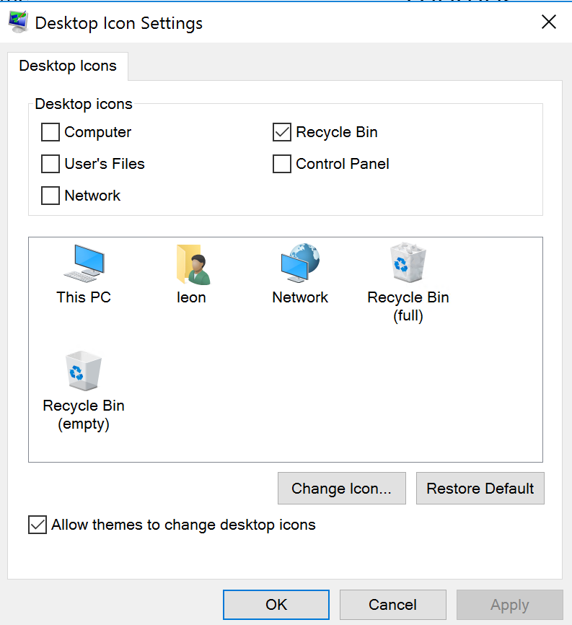
Installing Standard User’s Icons on Windows Server 2016
Right-click on desktop
Select “Personalize” from menu
Select “Themes” from personalization menu
Select “Desktop Icon Settings”

Slide 42
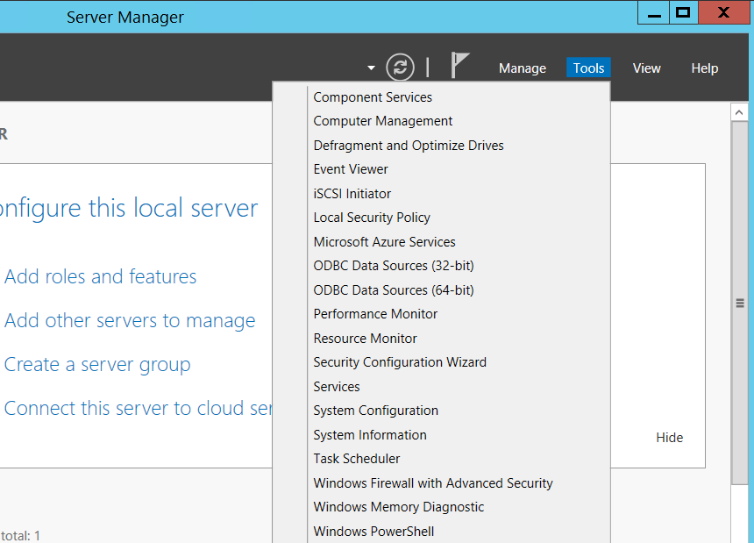
Managing Disks on VM

Slide 43
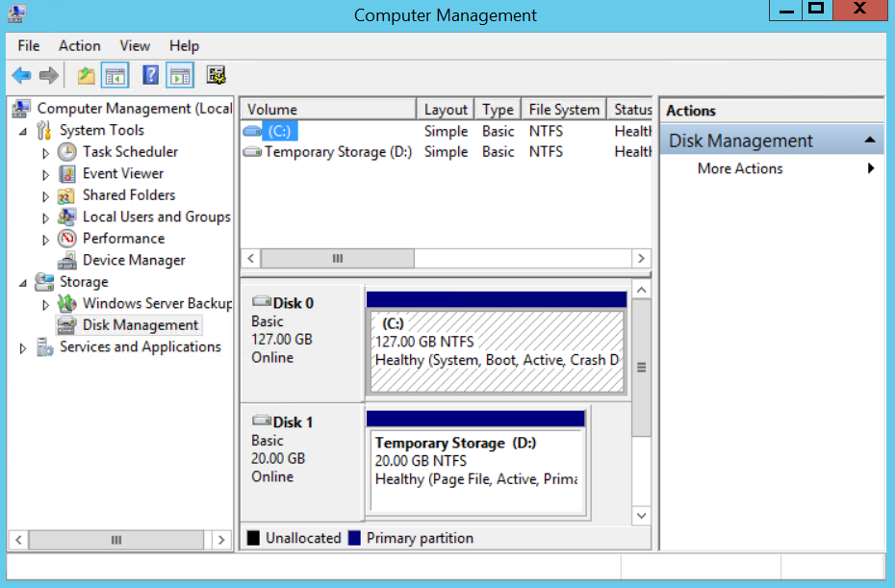

Slide 44
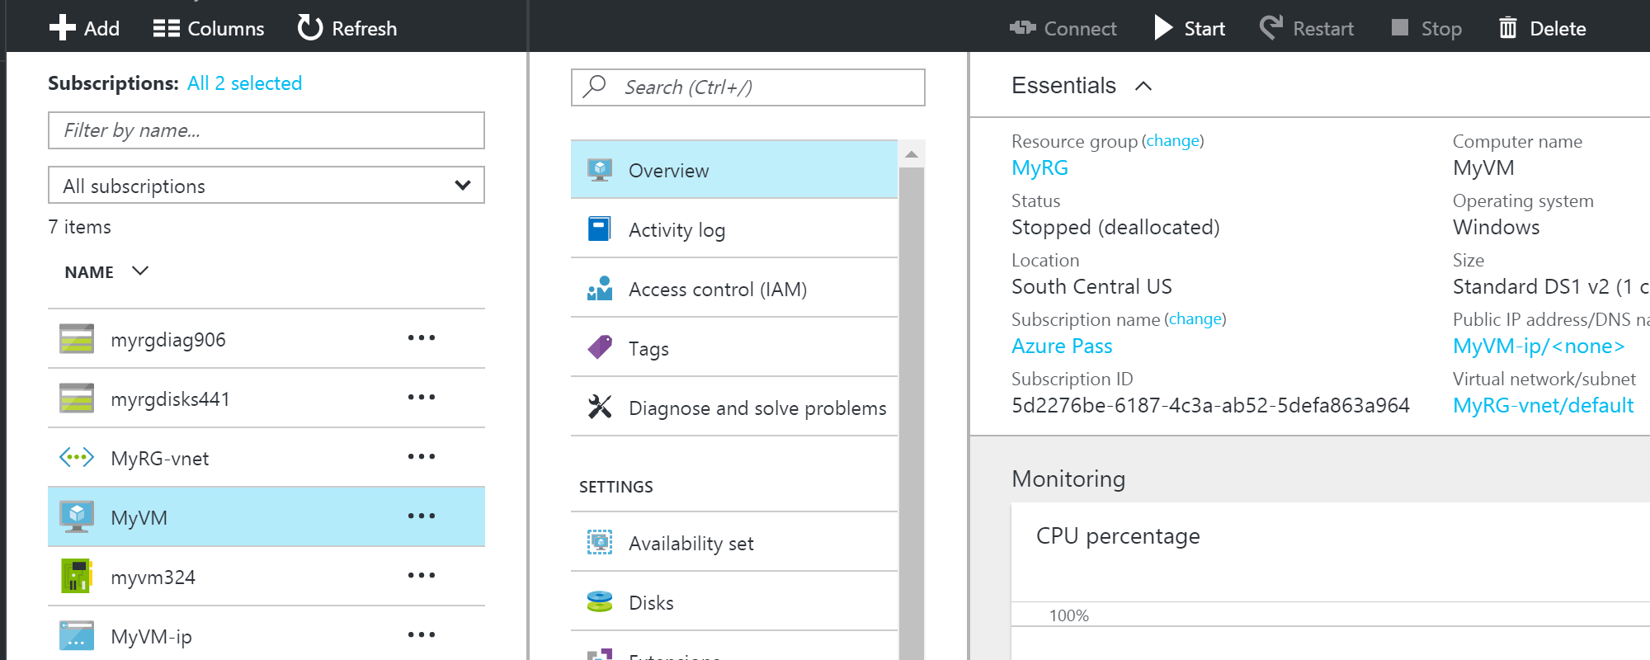
Attaching a data disk to the Windows VM in the Azure portal
First, Stop the VM, then click on “Disks”

Slide 45
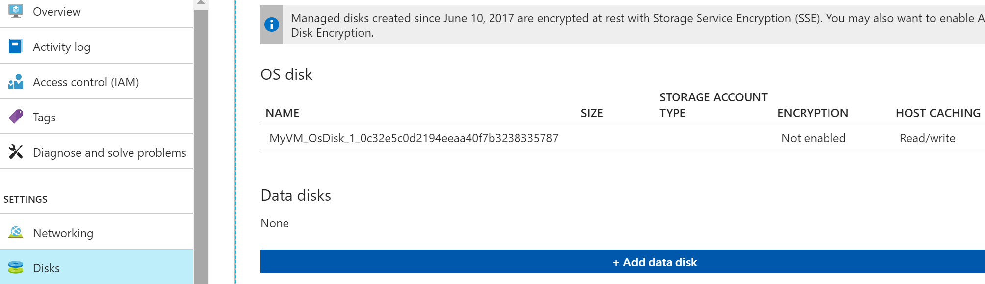
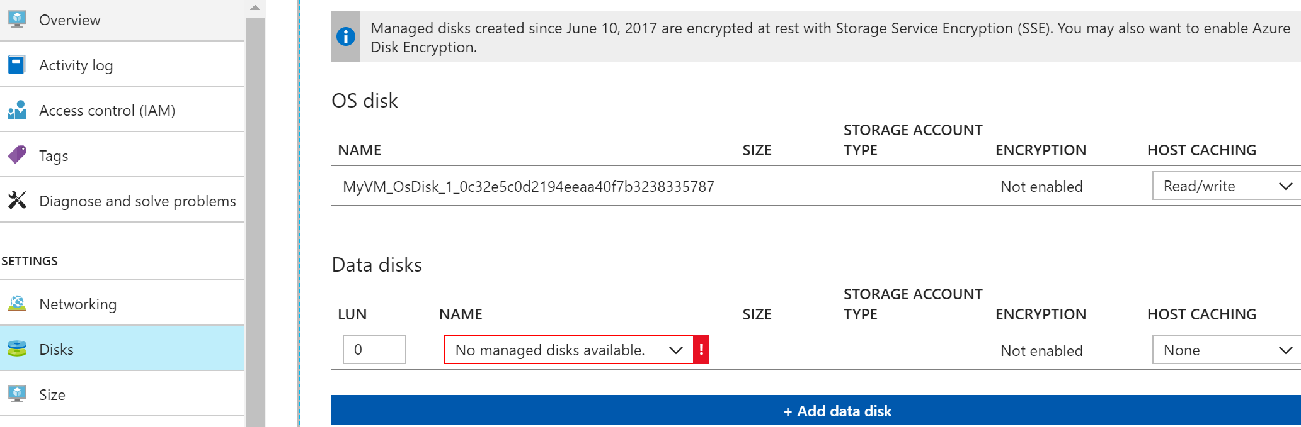
Click on “Add data disk”
Select “Create disk” from drop-down menu

Slide 46
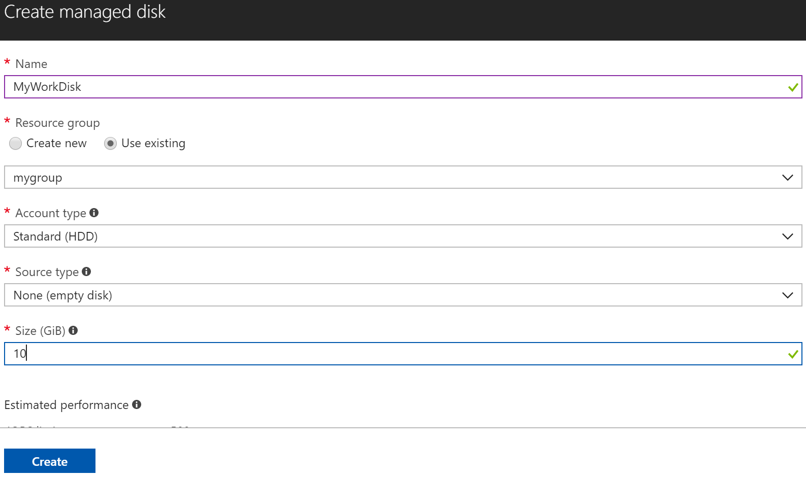
Specify parameters, then click “OK”

Slide 47
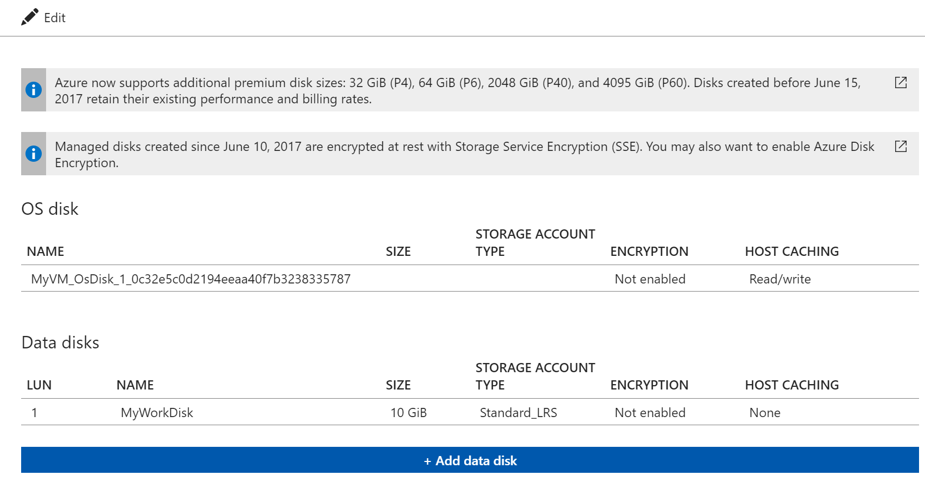
New Disk Added

Slide 48
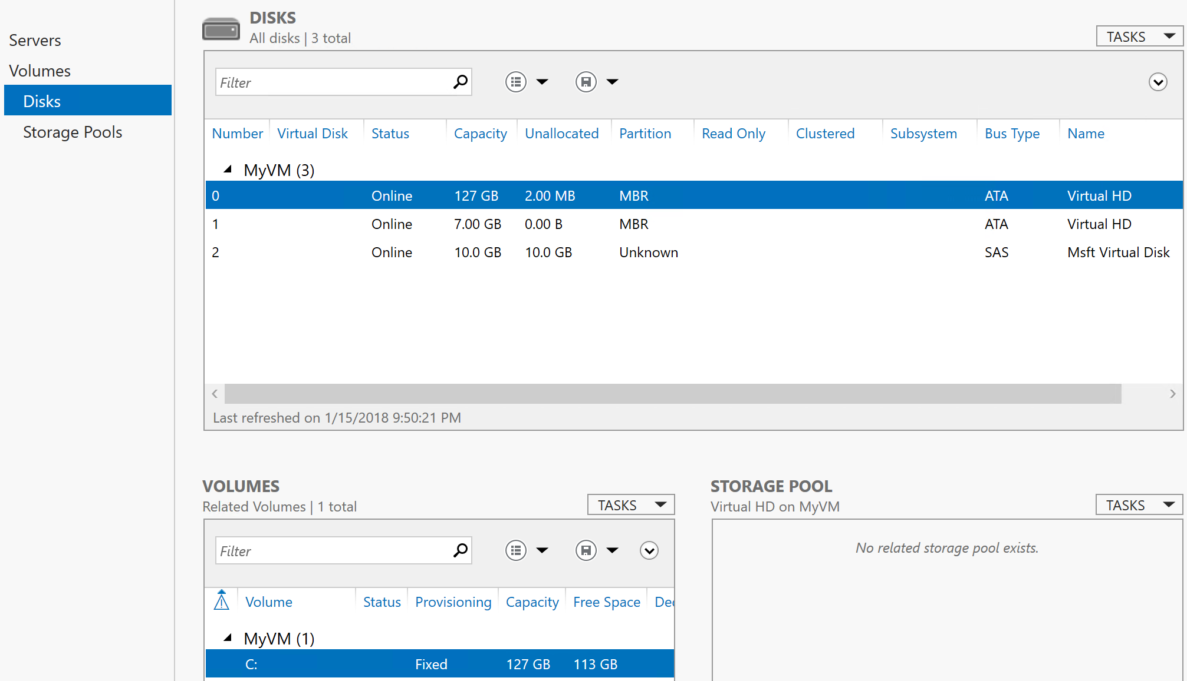
Initializing the New Disk
Log on to the VM
Open Server Manager
In the left pane, select File and Storage Services
Expand the menu and select Disks

Slide 49
The Disks section lists the disks. In most cases, it will have disk 0, disk 1, and disk 2.
Disk 0 is the operating system disk, disk 1 is the temporary disk, and disk 2 is the newly attached disk.
The new disk will be listed with the Partition as Unknown. Right-click the disk and select “Initialize”.
Confirm the warning that all data will be erased and initialize the disk.
The new partition will be listed as GPT. Right-click the disk again and select “New Volume”.
Complete the wizard using the default values.
When the wizard is done, the Volumes section lists the new volume. The disk is now online.

Slide 50
Bringing the New Disk Online
The Disks section lists the disks. In most cases, it will have:
disk 0: Operating system
disk 1: Temporary disk
disk 2: Newly attached disk
The new disk will be listed with the Partition as Unknown.
Right-click the new disk and select “Initialize”.
Confirm the warning that all data will be erased.
The new partition will be listed as GPT.
Right-click the disk again and select “New Volume”.
Complete the wizard using the default values.
When the wizard is done, the Volumes section lists the new volume.
The disk is now online.

Slide 51
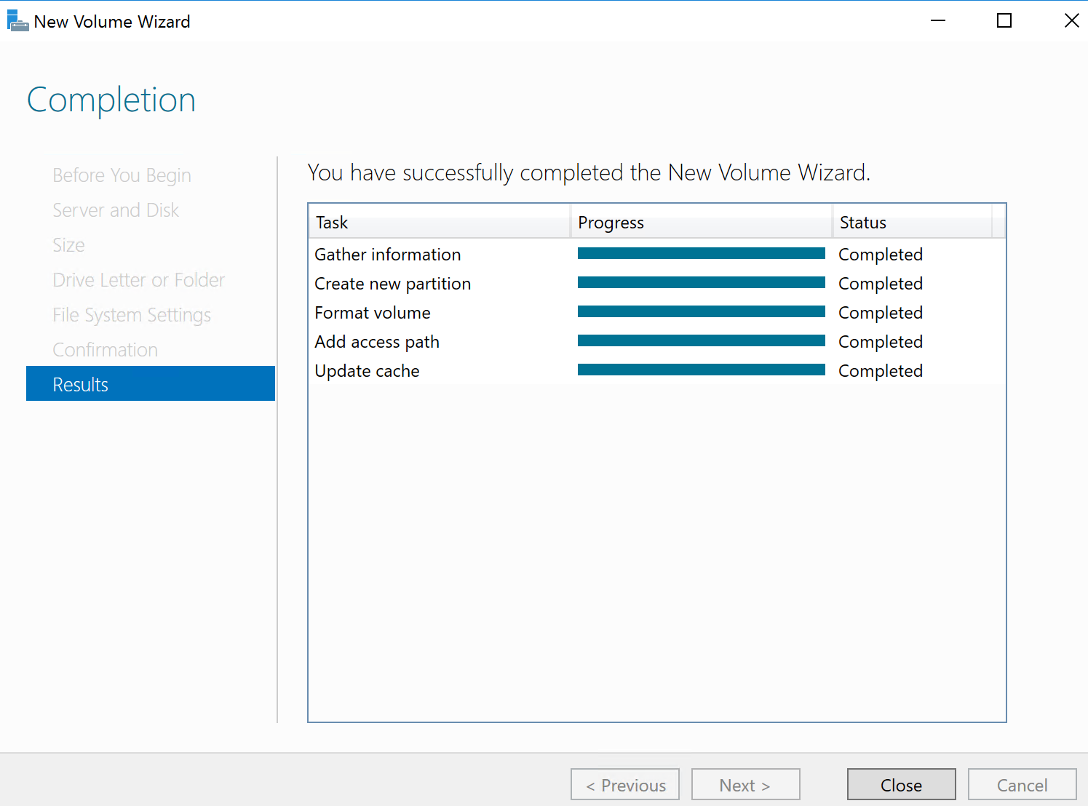
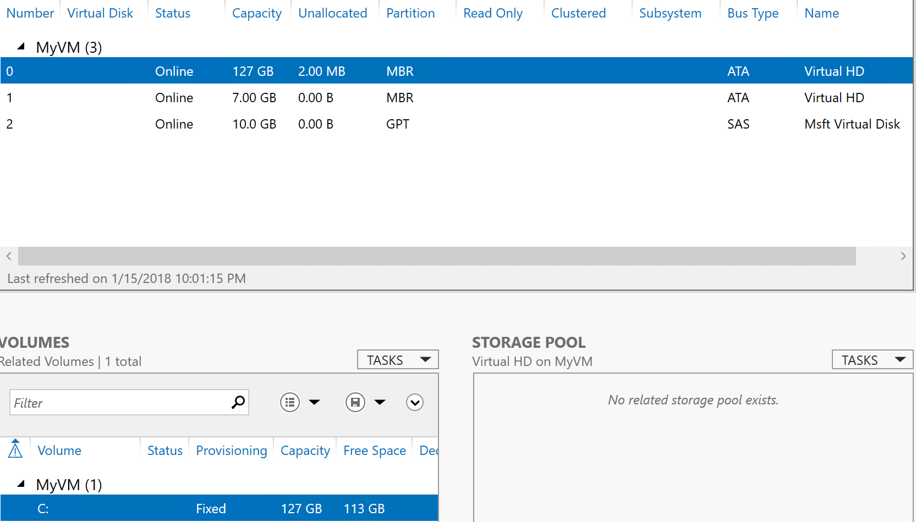

Slide 52
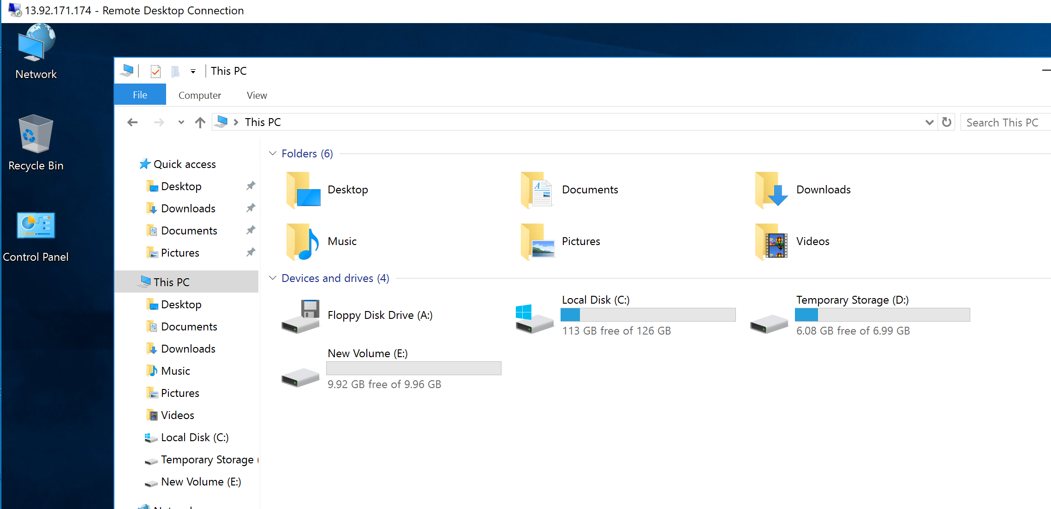
The Newly Allocated Disk

Slide 53
Installing IIS on Windows Server 2016
Open Server Manager (on the VM)
Select “Add Roles and Features” from dashboard menu
On the “Before you begin” window, click Next
On the “Select installation type” window, leave “Role-based or feature-based installation”, click Next
Choose “Select a server from the server pool” with the current machine selected and click Next
From the “Select server roles” window, check the box next to “Web Server (IIS)”. This may open up a new window regarding additional required features, click the “Add Features” button to install these as well
On the “Select features” window, click Next (no additional features are needed)
On the “Web Server Role (IIS)” window, click Next

Slide 54
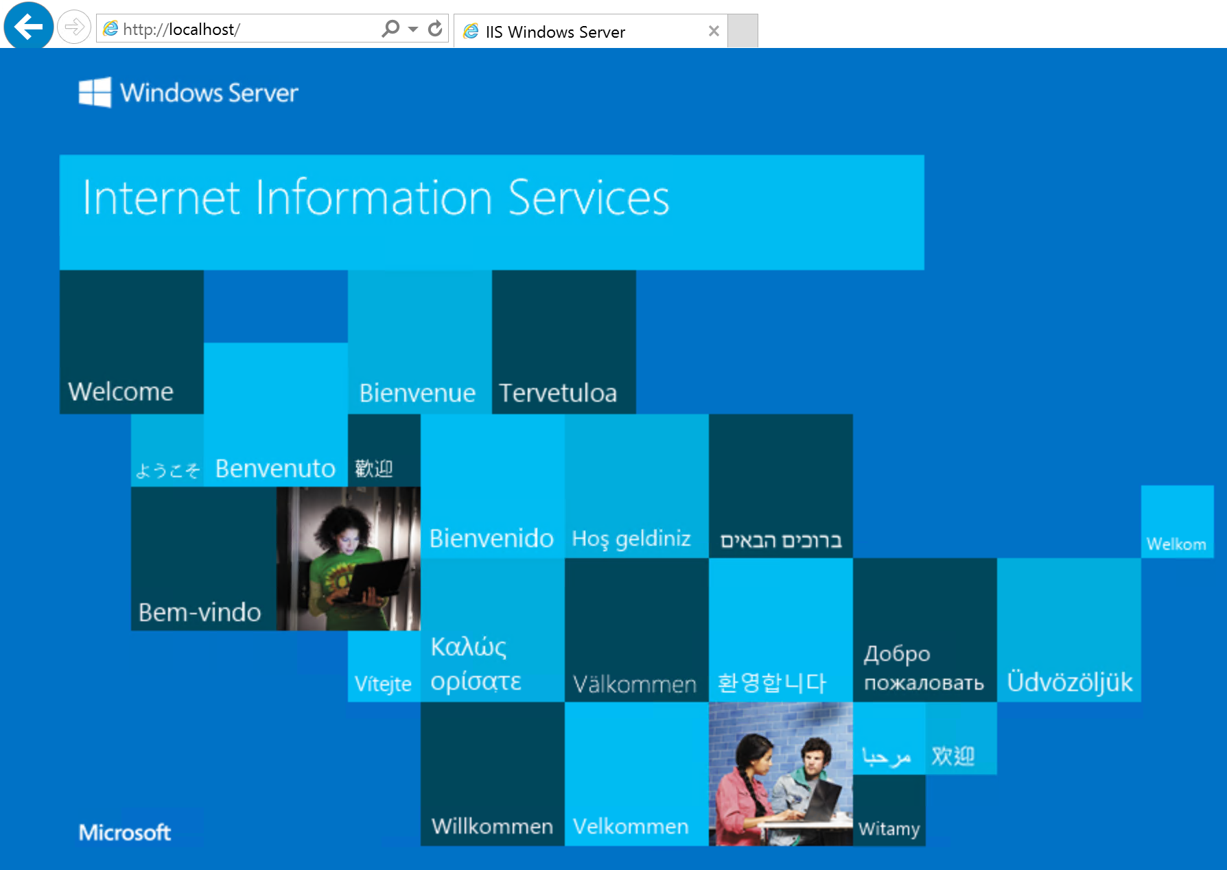
On the “Select role services” window, click Next (additional services for IIS can be later installed, if required)
On the “Confirm installation selections” window , click install
No reboot should be required with a standard IIS installation
Once the installation has succeeded, click the close button. IIS should be running on port 80 by default with the firewall rule “World Wide Web Services (HTTP Traffic-In)” enabled in Windows firewall automatically.
To test installation, open up a web browser with the URL of the local host. The default IIS page will be displayed.

Slide 55
Assignment
Provision two virtual machines running Windows Server 2016 on the Azure cloud platform.
Configure the security rule to allow external access to Port 80.
Install the IIS web Server on each VM.
Modify the default web page of the IIS server to show your name.
Verify that you are able to access the web server of one VM from the other VM.

Slide 56
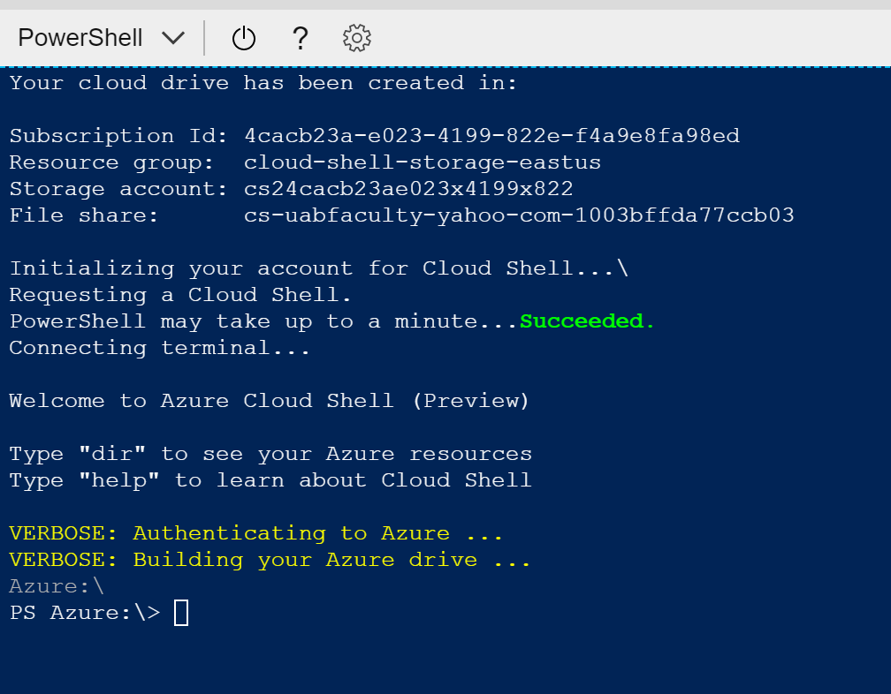

Slide 57
Creating a Windows VM with PowerShell
(Azure PowerShell) Create resource group:
New-AzureRmResourceGroup -Name myResourceGroup -Location EastUS
(Azure PowerShell) Create virtual machine:
New-AzureRmVm `
-ResourceGroupName "myResourceGroup" `
-Name "myVM-2" `
-Location "East US" `
-SubnetName "mySubnet" `
-SecurityGroupName "myNetworkSecurityGroup" `
-PublicIpAddressName "myPublicIpAddress" `
-OpenPorts 80,3389

Slide 58
(Azure PowerShell) Get the public IP address of the VM
Get-AzureRmPublicIpAddress -ResourceGroupName myResourceGroup | Select IpAddress
(Local machine) create a remote desktop session with the VM:
mstsc /v:<publicIpAddress>
(VM) Install IIS:
Install-WindowsFeature -name Web-Server -IncludeManagementTools
(Azure PowerShell) Clean up resources:
Remove-AzureRmResourceGroup -Name myResourceGroup

